Slide 1
CLEP Opening Statement Building Science Innovators by Myron Katz, PhD
Entergy New Orleans Rate Case
DOCKET NO. UD-18-07
June 17, 2019 Evidentiary Hearing

Slide 6
Notes:
* Far better than old-school time-of-use rates, that have no means to pay for avoided demand,
* Clep outstandingly addresses: environmental and reliability issues, and greatly helps to make utility services far more affordable, for low- and middle-income consumers. All the while,
* Clep rapidly grows tidal-waves of new blue-color jobs, via the large number of market-transformations it creates, by
* financing a plethora of low-tech, building-energy-performance equipment, that by-and-large, cannot be otherwise financed.
*Since CLEP income is overwhelming from avoided demand, old-school time-of-use rates leave much to be desired.

Slide 8
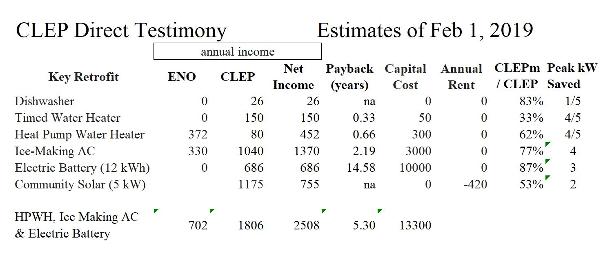

Slide 9
