Slide 1
Customer Lowered Electricity Price CLEP 10 min Pitch for 12Apr17 #BrightMindsChallenge
Myron Katz, Ph.D. Energy, Moisture & Building Science Consultant Building Science Innovators, LLC. 302 Walnut St New Orleans, La 70118 504-343-1243 cell / office Myron.Katz@EnergyRater.com
Notes:
This PowerPoint faithfully describes the content in an accompanying PDF file “CustomerLoweredElectricityPrice-PitchFor12Apr2017-v46.pdf” which was created to compete in the #BrightMindsChallenge semi-finals, pitch competition held in Cambridge, MA on 12Apr17.
Each member of the audience will be well served by printing the PDF file in color (or simultaneously accessing it privately on their own computer) since the last 9 pages of PDF faithfully correspond to the content in the following eight slides and thereby provide greater granular detail access to issues that will definitely come up in the following 15 minute discussion. Moreover, that document has footnotes that are not found in this PPT.

Slide 2
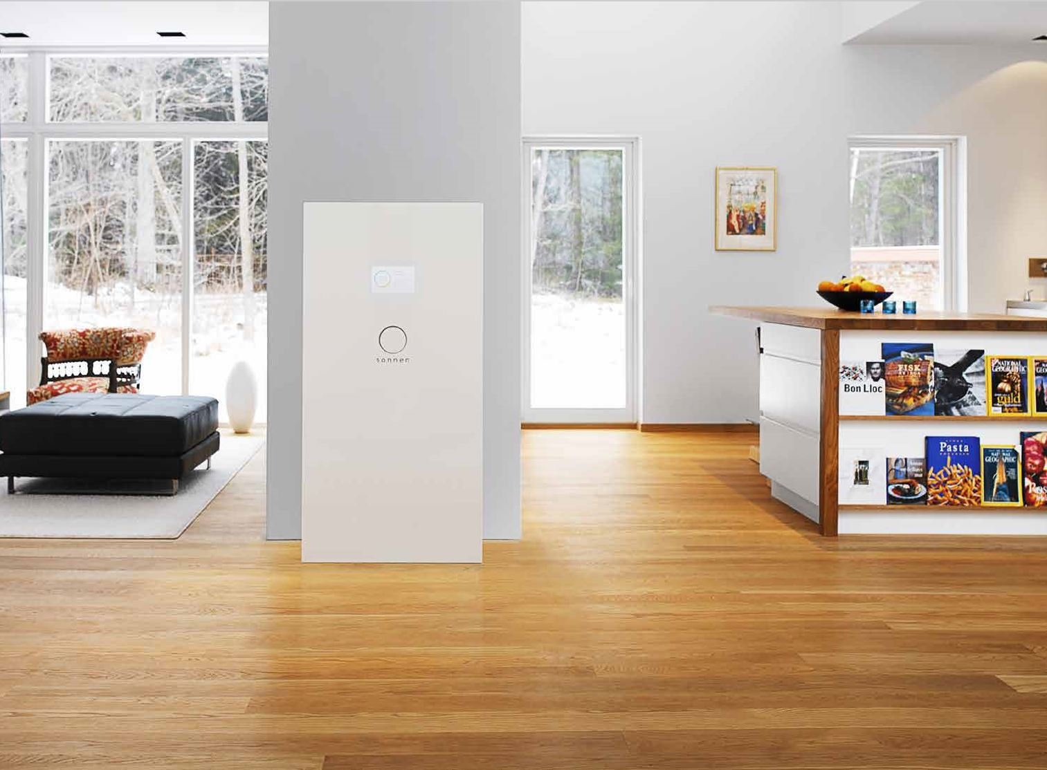
Notes:
Einstein once said, “If I had an hour to solve a problem and my life depended on it, I’d use 55 minutes to find the right question...” After decades of thinking about this, I believe that I FINALLY found the right question:
How can we ENGAGE the MARKET PLACE to solve CLIMATE CHANGE?
And, a very good an answer: Customer Lowered Electricity Price or CLEP. CLEP will
Revolutionize how electricity is bought and sold—by letting every customer participate in the wholesale market. And it will put control of the grid where it belongs—in the hands of the consumer.
Lower electricity prices for all of us and provide net income for some, and
Allow us to use the latest battery technology in our homes — like the one pictured— by offering a way to fully finance them, and ensure resilience against a changing climate. But… Why the emphasis on home batteries?
Home batteries turn power customers into energy customers and thus cause a fast & cheap transition to a 100% renewable energy future.
How does CLEP do all this?
Powered and controlled by supply and demand CLEP rewards timely consumption and sales AND reduced demand;
and by so doing, CLEP doubles cashflows for energy efficiency and renewable energy.
The best way to try CLEP employs its multi-home battery pilot. Selling it, shouldn’t be so hard, because such a pilot was already approved in Rutland, VT—but ours has one very important difference — ours will be FINANCED with CLEP!

Slide 3
Definitions of Customer Lowered Electricity Price, (CLEP)
For a residential ratepayer who voluntarily accepts the CLEP tariff,
A Monthly CLEP Payment = CLEPm + ∑ CLEP5
where: CLEP5 = p * n * (e - w) is calculated every 5 min
p = Utility-regulator determined, “percent” and 0 < p < 2;
n = Number of kWh purchased by the customer.
If the flow is outbound (i.e., a sale), n is negative;
w = Wholesale cost of power
e = Monthly average cost of energy (fuel cost adjustment)
where: CLEPm = q * $50 * d is calculated monthly
d = Average demand during utility peak hours avoided
(i.e., d = observed reference building demand minus observed demand)
q = Utility-regulator determined “percent” and 0 < q < 2.
For a non-residential ratepayer who voluntarily accepts the CLEP tariff,
CLEP is the same as defined for residential ratepayers except,
CLEPm is redefined and replaces all demand charges
CLEPm = q * $50 * d is calculated monthly
d = Average demand during utility peak hours
When d is positive, CLEPm creates a high demand charge paid by the customer.
When used to finance Community Solar,
CLEP is the same as defined for non-residential ratepayers except,
CLEP5 is replaced with p * n * w
Notes:
A. The “$50” factor in CLEPm’s definitions may be adjusted to optimally encourage CLEP acceptance but not undermine: CLEP transactions lower the electricity price for all customers.
B. The negative demand charge paid to a residential customer viewed in $/KW-y should not exceed 2x the highest demand charge paid by a non-residential, non-CLEP customer in $/KW-y.
C. If a customer does not have air-conditioner-dominated demand, then replace $50 with $50/2.
D. Utility peak hours are annual and occur within May through Sept, weekdays, and are between 2 p.m. and 7 p.m.; otherwise CLEPm = $0 for that month.
E. CLEPm generates a payment whenever average demand during peak hours is negative.
F. Avoided demand is observed by real-time comparison to performance of homes of similar age.
G. “p” and “q” are extra controls to allow the utility regulator to ensure that goals are met.
Buy Low Sell High
Negative Demand Charge
Notes:
HOW DOES CLEP WORK?
(This slide shows CLEP’s formal definitions -- needed to create utility bills.)
CLEP customers pay their normal electric bills; but, also receive two cashflows:
CLEP5 pays for buying when wholesale prices are low, and for selling when prices are high,
CLEPm pays a “negative demand charge” reward for low demand during peak hours.
Using (utility-provided) smart meters, customers effectively buy and sell at real-time wholesale prices AND are paid to avoid demand at the same annual rate as (the utility) charged commercial customers.
All CLEP income comes from current or future utility-cost savings.
Since the utility retains 5%, CLEP lowers prices for ALL — not just those who chose CLEP.
The next table shows CLEP IN ACTION.

Slide 4
Probable First Costs and Annual Savings of CLEP
for a Customer using Entergy New Orleans Electricity
 | First Cost | Annual Savings without CLEP |  | Additional¹ or Alternative² Annual Savings with CLEP |  |  | CLEP VS no CLEP
 |  | $ | lbs of CO₂ | CLEP5 | CLEPm | lbs of CO₂ | $ / $
Dishwasher | $0 | $0 | 0 | $6 | $20 | 130¹ | 130 / 0
Water Heater | $1000 | $250 | 2500 | $20¹ | $250¹ | 570¹ | 520 / 250
Community Solar | $5,000 | $900 | 10800 | $360² | $625² | 0¹ | 985 / 900
Whole Home Battery | $10,000 | -$10 | 0 | $100 | $900 | 2400¹ | 1000 / 0
Rooftop Solar with Battery | $27,500 | $900 | 10800 | $250² | $1550² | 0¹ | 1800 / 900
^{[1}
Notes:
CLEP’s First Costs and Annual Savings shows $ & CO2 savings for 5 ways to apply CLEP
CLEP5 and CLEPm are in separate columns. For energy efficiency, these values are additional income, but are alternative income for the solar examples.
The last column shows that cashflows for EE and rooftop solar double.
The 5 ways to use CLEP — ordered by increasing investment — are
Programming appliances for off-peak use —reduces wholesale prices and peak demand costs, but maybe not kWh’s used.
Energy efficiency investments — were already covered.
Community solar (jointly-owned and locally sited) is 3 x as accessible and lucrative, so lucrative — it allows 20% subsidies to low income residents.
Whole-home batteries project ten-year payback for a $10,000 battery; good, because that’s their warranty period.
Rooftop solar with a battery — reaps 100% more than solar alone — because of timely production.
But what happens when the grid goes down or a Storm Comes?

Slide 5
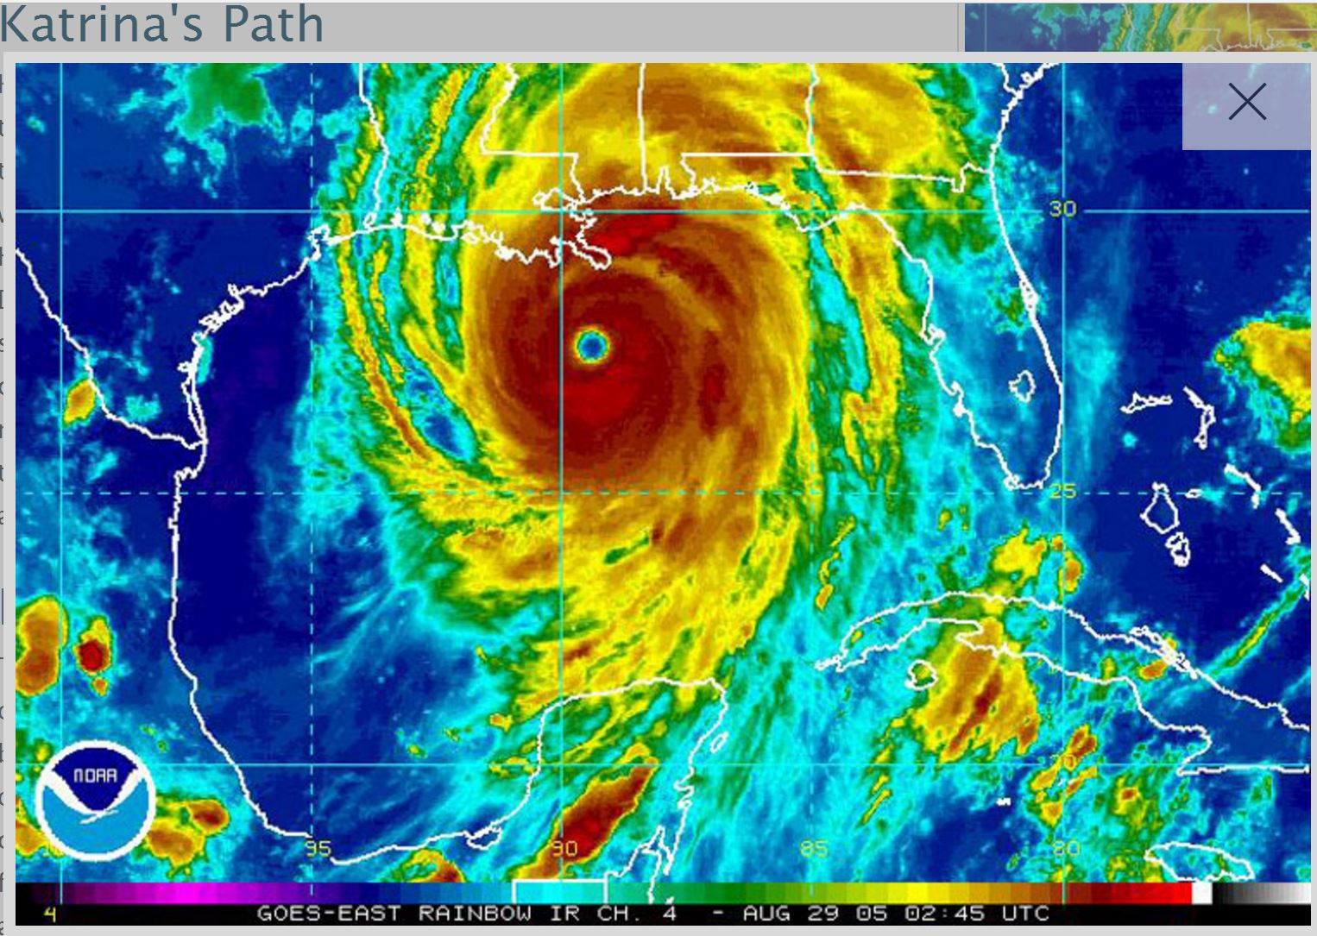
Notes:
Investing in buildings is still where we need to focus, but we can no longer afford to dismiss batteries.
I’ve come up with the term whole home batteries to describe what I published 3 years ago –
that all homes need them,
they can be financed by savings on both sides of the meter, and
they should be able to store a day’s electricity in 4 hours. BSI, 2014
The SOCIETAL benefits of home batteries dwarf the100% renewables goal of this competition for many people, because they provide reliability, excellent power quality, resilience — and can save lives!
So, along with 100% renewables goal, we need lots of home batteries, and, in fact, batteries in all buildings.
Switching from power to energy provider avoids trillions in infrastructure. This (grid) model is easily exported to developing countries — where most electricity will be used by 2050; In fact, many such countries already have energy provider grids.
So, if batteries are so good, how can get them into buildings?

Slide 6
 |  | CLEP Battery Pilot Cashflow Over 10 years |  |  |  |  |  |  |  | First & last years are 6 months long
Sold Units | Year | 1 | 2 | 3 | 4 | 5 | 6 | 7 | 8 | 9 | 10 | 11 | SUMS
Total # of Units Sold |  | 600
Mid-Year Convention |  | 300
Cumulative # Units Sold |  | 300 | 600 | 600 | 600 | 600 | 600 | 600 | 600 | 600 | 600 | 600
# Sold under Direct Control |  | 200 | 400 | 400 | 400 | 400 | 400 | 400 | 400 | 400 | 400 | 200
DOLLARS
Sales Retail Revenue |  | $10,920,000 |  |  |  |  |  |  |  |  |  |  | $10,920,000
Wholesale Costs of sold units |  | $8,400,000 |  |  |  |  |  |  |  |  |  |  | $8,400,000
Sales Tax |  | $840,000 |  |  |  |  |  |  |  |  |  |  | $840,000
Bill Credit for Control by Utility |  | $285,000 | $570,000 | $570,000 | $570,000 | $570,000 | $570,000 | $570,000 | $570,000 | $570,000 | $570,000 | $285,000 | $5,700,000
Power Supply benefit from control |  | $300,000 | $600,000 | $600,000 | $600,000 | $600,000 | $600,000 | $600,000 | $600,000 | $600,000 | $600,000 | $300,000 | $6,000,000
Leased Units
Total # Units Leased |  | 400 | 400 | 400 | 400 | 400 | 400 | 400 | 400 | 400 | 400 | 400
Mid-Year Convention |  | 200 | 400 | 400 | 400 | 400 | 400 | 400 | 400 | 400 | 400 | 200
DOLLARS
Undepreciated Leased Assets |  | $3,080,000 | 5,852,000 | 5,236,000 | 4,620,000 | 4,004,000 | 3,388,000 | 2,772,000 | 2,156,000 | 1,540,000 | $924,000 | $308,000 | $0
Lease Revenue |  | $105,600 | $211,200 | $211,200 | $211,200 | $211,200 | $211,200 | $211,200 | $211,200 | $211,200 | $211,200 | $105,600 | $2,112,000
Power Supply benefit from control |  | $300,000 | $600,000 | $600,000 | $600,000 | $600,000 | $600,000 | $600,000 | $600,000 | $600,000 | $600,000 | $300,000 | $6,000,000
Depreciation |  | $308,000 | $616,000 | $616,000 | $616,000 | $616,000 | $616,000 | $616,000 | $616,000 | $616,000 | $616,000 | $308,000 | $6,160,000
Return on Rate Base |  | $338,800 | $643,720 | $575,960 | $508,200 | $440,440 | $372,680 | $304,920 | $237,160 | $169,400 | $169,400 | $33,880 | $3,726,800
Marketing |  | $5,000
Other O&M |  | $100,000 | $10,000 | $10,000 | $10,000 | $10,000 | $10,000 | $10,000 | $10,000 | $10,000 | $10,000 | $10,000 | $200,000
Contribution to Cost of Service |  | $1,348,800 | $428,520 | $360,760 | $293,000 | $225,240 | $157,480 | $89,720 | $21,960 | $45,800 | $113,560 | $68,720 | $200
Notes:
FROM PROTOTYPE to IMPLEMENTATION: CLEP’s 10-year BATTERY PILOT’s business model is based on Rutland, VT’s 2015, utility-initiated & -funded pilot.
It will deploy 12 MWH among 1000 residences.
If you look at the numbers, highlighted in yellow — the utility’s out-of-pocket cost (Undepreciated Leased Assets) peaks at $5.8 million in the 2nd year and goes to ZERO in ten years using 4 cashflows: $2.5 (million) profits from sales; $6 (million) from depreciation, $3.7 (million) for rate of return profit; $6 (million) from CLEP-associated savings
ALL without burdening non-participants (Contribution to Cost of Service).
This distributed power plant supplies 8 MW for 1.5 hours and can be 100% cycled, 3 times daily, for a decade.
( That’s thrice daily for 250 fortnights — if you’re British! )
So, for 3/4 the $1/W price of a 200 MW peaking plant — it pays back 3X faster and has tiny operating costs.
Deploying 25,000 batteries matches the peaking plant’s capacity but with a 10 X higher capacity factor.
But, in fact, peak demand WILL drop by much more than 200 MW, because CLEP pays in the 4 more ways already described (2 slides back).

Slide 7
Utility Regulators’ View of CLEP Compared to Alternative Strategies
Goals vs Strategies |  | Simple | Quick to Implement | Cheap to Implement | Continuously Effective | Improves Reliability | Low Administrative Cost | Low Regulatory Burden | Reduces Consumption | Reduces Demand | Promotes Energy Efficiency | Requires Smart Meters |  | Shifts Time of Use | Market Transformations | Shaves Peaks | Treats Peak's Shoulders | Not a Subsidy | Timely Charge or Reward | Balances Supply vs Demand | Helps Finance Rooftop Solar | Looks Like a Subsidy | Pays as well as Retail | Reduces CO₂ Production | Tax | Finances Community Solar | Real Performance Based | Lowers Electricity Prices | Market Based | Adequately Granular | Adjusts to Changes | Fully Pays for Whole Home Batteries
Fixed Price Rates |  | x | x | x |  |  | x | x
Demand Charges |  | x |  |  | x |  |  | x |  | x |  |  |  |  | x | x | x |  |  |  |  |  |  | x
Inclining Block Rates |  |  |  |  | x |  |  |  | x |  | x |  |  |  |  |  |  |  |  |  |  |  |  | x
Time of Use Rates |  |  |  |  | x | x |  |  |  | x |  | x |  | x | x | x | x |  | x |  |  |  |  | x
Load Management |  |  |  |  |  | x |  |  |  | x |  |  |  |  | x | x |  |  |  |  |  |  |  | x |  |  |  |  |  |  | x
Demand Response |  |  |  | x |  | x |  |  |  | x |  |  |  |  | x | x |  |  |  |  |  |  |  | x |  |  |  |  |  |  | x
Demand-Side Management |  |  |  |  |  |  |  |  | x | x | x |  |  |  |  |  | x |  |  |  |  |  |  | x
Consumer Education |  | x |  | x | x |  | x | x | x |  | x |  |  | x |  |  |  |  |  |  |  |  |  | x
Critical Peak Pricing |  |  |  | X |  | x |  |  |  |  |  | x |  |  |  | x |  |  | x |  |  |  |  | x |  |  |  |  |  |  | x
Peak Time Rebate |  |  |  | x |  | x |  |  |  |  |  | x |  |  |  | x |  |  | x |  |  |  |  | x |  |  |  |  |  |  | x
Real-Time Pricing |  |  |  | x | x | x |  |  |  |  |  | x |  |  |  | x |  |  | x |  |  |  |  | x |  |  |  |  | x | x | x
Net Energy Metering |  |  |  |  | x |  |  |  | x | x |  |  |  |  | x |  |  |  |  |  | x | x | x | x |  | x | x
Value of Solar |  |  |  |  | x |  |  |  | x | x |  |  |  |  | x |  |  |  |  |  | x |  |  | x |  | x | x
Integrated Resource Planning |  |  |  |  |  | x |  |  | x | x
Carbon Tax |  |  |  |  | x |  |  |  |  |  |  |  |  |  |  |  |  |  |  |  |  |  |  | x | x |  | x
CLEP |  |  | x | x | x | x | x | x | x | x | x | x |  | x | x | x | x | x | x | x | x |  | x | x |  | x | x | x | x | x | x | x
Notes:
The Utility Regulators’ View of CLEP Compared to Alternative Strategies graphic illustrates CLEP’s uniqueness and benefits.
This tables lists 30 ATTRIBUTES, or GOALS, that characterize electricity delivery, like Improves Reliability, Promotes EE or Not a Subsidy, vs 15 STRATEGIES used to achieve them, like Inclining Block Rates, Demand Response or Net Energy Metering.
Notice that CLEP is the only strategy that accomplishes most of the goals, and CLEP is the only way to fully fund whole-home batteries.
Like Time-of-Use Rates, CLEP lowers demand during peak hours, but unlike TOU rates, CLEP also lowers total kWh consumption.

Slide 8
CLEP Endorsements
New Orleans
Neil Abramson, J.D.; Ways & Means Chairman, Louisiana House of Representatives
James Gray, J.D.; New Orleans City Councilman; Utility Committee member; very interested in CLEP
Pres Kabakoff, Pres., HRI Properties; national real estate developer; civic leader; philanthropist
Marcel Wisznia, AIA; Past Pres AIA of LA., Wisznia Associates; developer; business-civic leader
Tommy Milliner, J.D.; utility watchdog advocate for over two decades; Energy Law Fellow, Tulane Univ.
Daniel Weiner, AIA; LEED AP; past president The Green Project; a founder of Tulane Green Club
Z Smith, PhD, AIA; solar technology innovator; past president USGBC, Louisiana
National Energy Industry Professionals
Michael Holtz, FAIA; President, Light Louver; past President, Architectural Energy Corp. (developer of REM/Rate); past Chief, Bldg Systems Research and Acting Director, Solar Energy Research Institute (now NREL); founding board member, RESNET
Richard Faesy, Prin., Energy Futures Group; Energy Efficiency Mgr., Vermont Energy Investment Corp; founding board member, RESNET; RESNET Lifetime Achievement Awardee
Ken Fonorow, founding president National Energy Raters Association; board member RESNET, RESNET Market Transformation Leadership awardee, consultant for 1st Zero Energy Home, SE U.S.
Gary Nelson, Owner, Energy Conservatory; innovator of building performance testing and diagnostics instruments
Gary Klein, Gary Klein & Associates; Staff of California Energy Commission; water and sustainability consultant & RESNET leader
Dennis Stroer, current board member RESNET; past president, National Energy Raters Association
Gabrielle Stebbins, past Executive Director, Renewable Energy Vermont
Ned Ford, National Global Warming and Energy Committee, Sierra Club; Energy Efficiency analyst, activist and advocate in Ohio
Notes:
CLEP SHOULD WIN THIS COMPETITION because
CLEP is unique in the following ways
It shifts the utility economic structure from incentivizing what we don’t want to rapidly incentivize what we do — both economically and environmentally. CLEP does this by engaging the market place to —
1) Convert economic self-interest by one — into cost reductions for all,
2) Stimulate innovations that cause market transformations and create jobs, and
3) Reward activities that move us toward the goal of integrated resource planning
Moreover, CLEP is also very special because:
1) CLEP surpasses any 1 technology because it multiplies rewards for most technologies — whether renewables, batteries or efficiency — all will be more successful in a world with CLEP, and
2) CLEP (is apolitical because it) appeals to both the conservative & progressive mindsets.
Climate Change’s problems are far too broad, deep and imminent to look beyond the single solution that CAN REALLY ADDRESS their scope.
CLEP has been endorsed by many energy professionals
CLEP just needs one utility to run a pilot, iron out the kinks, and prove itself.
Thank you for your time and consideration.

