Slide 1
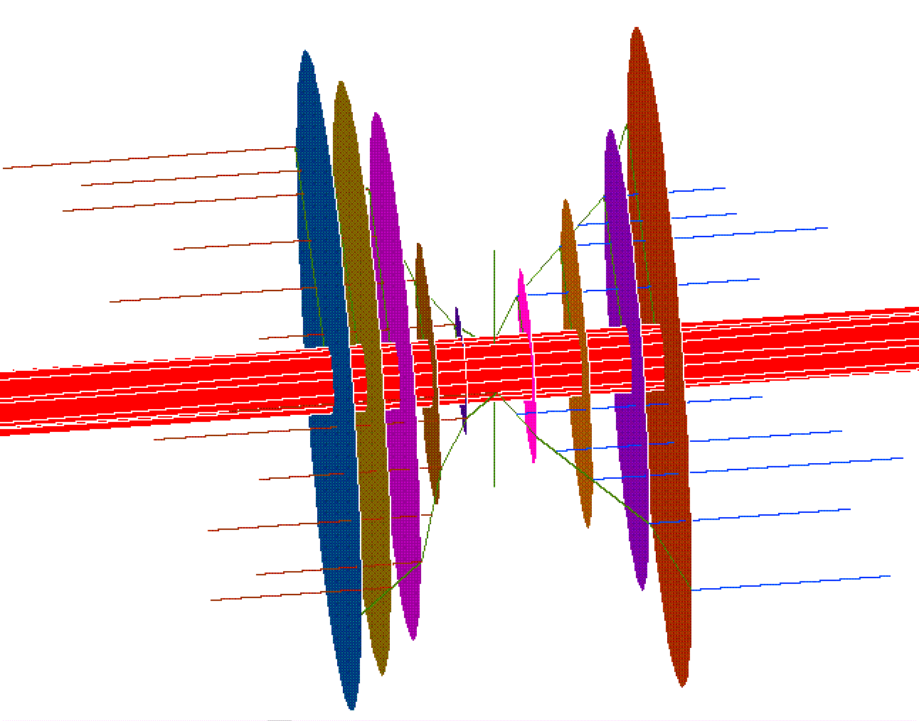


Poor Utility ↑Costs, Energy
Design & CO₂
RETAIL→
WHOLESALE→
EFFECTS
Leaky Economy
Grid Defections
Less Outlet Reliability
Poor Building Design
Less Renewables
Less Innovation
Less Retrofits
Stymied Appliance Design
Misallocation of Capital
IS CAUSED BY
Economic Dispatch
Try to be 100% Reliable
Erroneous Retail Prices
Cross-Subsidized Rate Classes
Mistaken Demand Charges
Stuck on Energy Efficiency
Weak Demand Response
Poor Performance Incentives
Won’t Buy Electricity Services
IDCC
CLEP
Notes:
This and the next slide are an orchestrated pair. Their goal is to highlight with words, colors and pictures the facts that poor utility design increases the 1) cost of electricity to retail customers, 2) primary energy used to make that electricity and 3) amount of CO2 generated.
The central graphic is meant to depict a full cone; where the red, central cylinder represents highly restricted wholesale electricity coming in from the left and expensive retail electricity leaving on the right.
The progressively smaller diameter and varied colored discs each depict a restricting cause, if on the left side, or progressively larger diameter effect, if on the right side, of poor utility design.
SAY THIS: Blue colored causes or effects can be ameliorated with IDCC; red with CLEP; purple with either IDCC or CLEP.
The larger diameter, blue cylinder appears in the second slide but not the first slide to indicate that once economic dispatch is abandoned, more wholesale energy flows in which results in less cost.

Slide 2
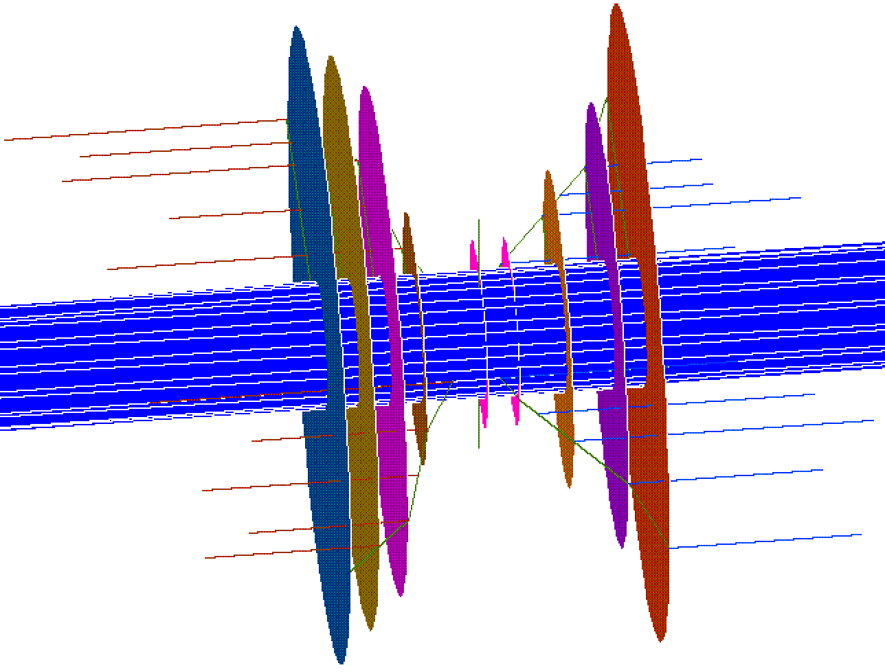
Good Utility ↓Costs, Energy
Design & CO₂
RETAIL→
WHOLESALE→
EFFECTS
Stronger Economy
No Grid Defections
More Outlet Reliability
Better Building Design
More Renewables
More Innovation
More Retrofits
Advanced Appliance Design
Invest on Demand Side
IS CAUSED BY
Less Economic Dispatch
4-hour Grid Reliability
Smart Retail Prices
Independent Rate Classes
Smart Demand Charges
Reward Timing & EE
Smart Demand Response
Smart Performance Incentives
Buy Electricity Services
IDCC
CLEP
Notes:
This and the next slide are an orchestrated pair. Their goal is to highlight with words, colors and pictures the facts that poor utility design increases the 1) cost of electricity to retail customers, 2) primary energy used to make that electricity and 3) amount of CO2 generated.
The central graphic is meant to depict a full cone; where the central red cylinder represents wholesale electricity coming in from the left and retail electricity leaving on the right.
The progressively larger diameter and varied colored discs each depict a restricting cause (if on the left side) or effect (if on the right side) of poor utility design.
Blue colored causes or effects can be ameliorated with IDCC. Red with CLEP. Purple with both IDCC and CLEP.
The larger diameter, blue cylinder appears in the lower slide but not the upper slide to indicate that once economic dispatch is abandoned, more energy flows at less cost.

Slide 3
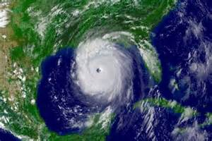
Improve the Economy while Cutting Carbon
Part 1. Inverted Demand Compliant Construction
Notes:
Do you think we can save this place? I hope so, but I’m more than hoping. I believe we can, but only if we try. This talk shows that we can get this done by engaging the market place to pursue its own self-interest: to be selfish regarding the economy of their homes and the size of their energy bills. The first talk, entitled Inverted Demand Compliant Construction, taps into the first need, Customer Lowered Electricity Price taps into the second.

Slide 4
Myron Katz, PhD
Energy Conservation, Moisture and Building Scientist
Building Science Innovators, LLC
302 Walnut St
New Orleans, La 70118
Myron.Katz@ EnergyRater.com
Inverted Demand
Compliant Construction
(IDCC),
A Key to a Renewable Energy Future
Given at EEBA Conference 9/21/14
http://www.eeba.org/Data/Sites/1/conference/2014/presentations/Katz-Inverted-Demand-Compliant-Construction.pdf
Notes:
4
An extended version of the IDCC talk was given about 1.5 years ago. It has many slides in it that I have excised to fit this talk into less time. You may find access to the earlier version of this talk useful for more in-depth understanding. It is easier to Google to the above link than to try to copy it. Just save EEBA in your notes, the organization that hosted the conference. The Google “EEBA IDCC Myron Katz” to find the link.

Slide 5
Improve the Economy While Cutting Carbon Emissions
Part 1. Inverted Demand Compliant Construction (IDCC)
Good Utility Design avoids 25% of US’s Carbon Emissions:
IDCC can significantly improve utility design
What is IDCC? Why so defined? & Why does it cost < $0?
IDCC + Updated grid design => Better reliability & ↓ cost
Enhances renewable energy economics, PV penetration and is easily exported to the developing world.

Slide 6
Good Utility Design Reduces ¼ of US’s Carbon Emissions
Optimal Utility Design minimizes the cost to get Electricity
High Electricity Price is Highly Correlated with High Carbon Content
Electricity Generators Produce 29% of US’s Carbon Emissions
Therefore, reducing ¼ of US’s CO₂’s Emissions does not negatively impact the economy; just the opposite is true.
The rest of this talk will show that for no net cost, IDCC can greatly improve utility design in just this way.

Slide 7
Electricity Generators
Produce 29% of
US’s CO₂ Emissions

Slide 8
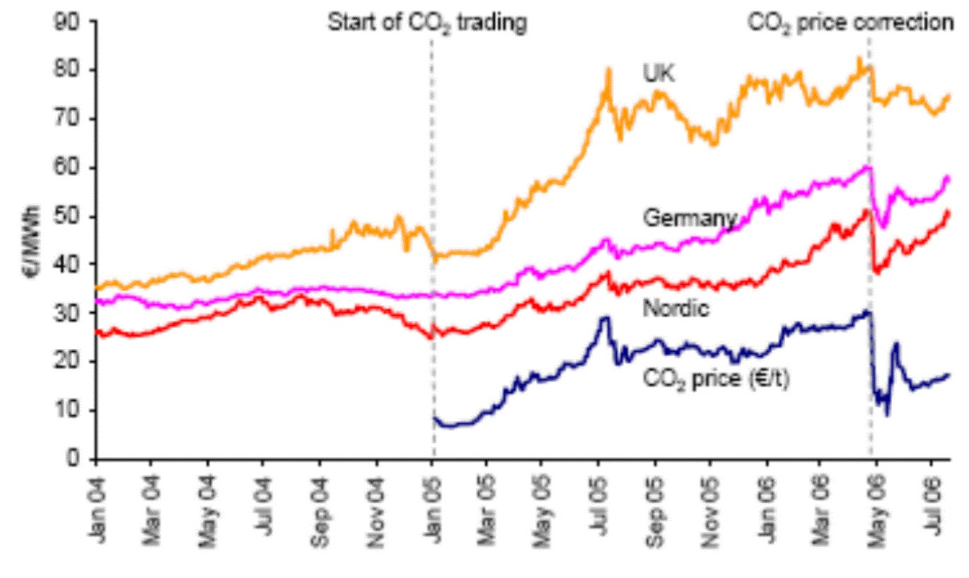
Wholesale Electricity Price is
Highly Correlated to
Carbon Content
Notes:
This slide shows that the wholesale price of electricity is strongly correlated with the amount of carbon released in its production and delivery. Thus, one easy way to grossly reduce CO2 production is to work hard to get our utilities to buy the cheapest wholesale electricity.
Who would be against that?

Slide 9
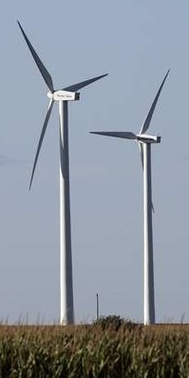
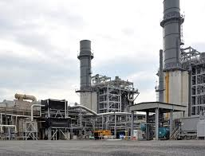

What is Economic Dispatch?
no yes
RETAIL→
WHOLESALE→
Notes:
Think of the conical image of wholesale electricity entering on the left. Note that the various restrictions in various colors restrict electricity flow into the economy (on the right).
The smallest aperture is caused by Economic Dispatch. Since utilities can control fuel-fired generation, they can make electricity on demand. Dispatch is the easiest, but the most expensive way to make electricity.
Dispatch usually excludes cleaner and cheaper renewable energy. Therefore, primarily, only more expensive energy flows are used and the economy is jeopardized.

Slide 10
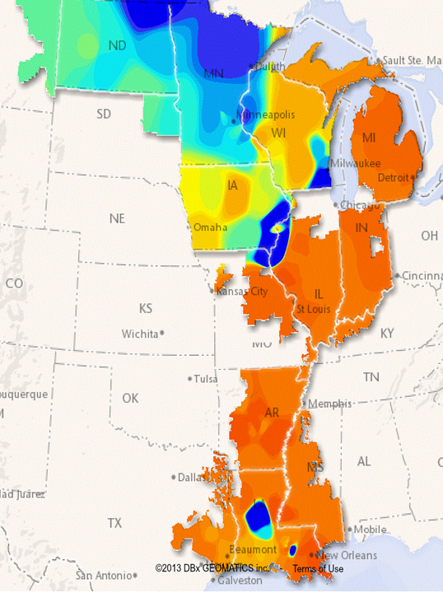
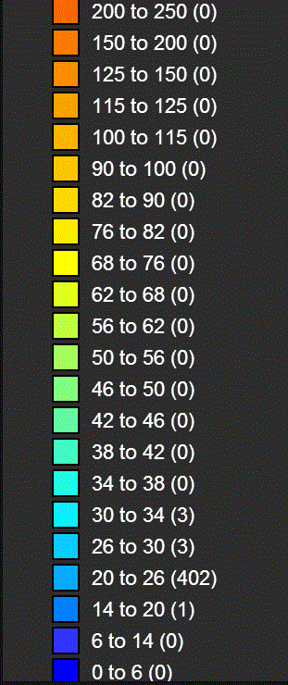
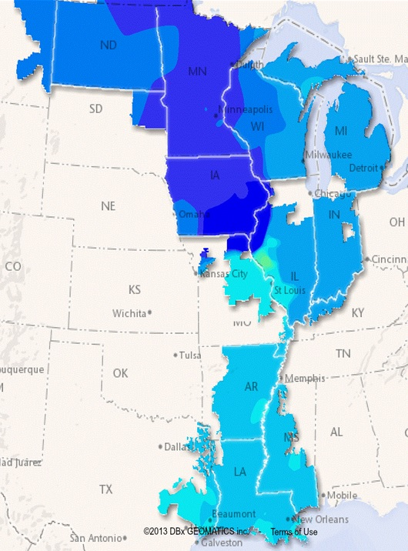
1¢/kWh
1¢/kWh
3¢/kWh
MISO on
09-10-14
@18:10
25¢/kWh
MISO on
09-11-14
@ 01:50
Notes:
MISO is the name of the wholesale marketplace servicing most of Louisiana. It is called the Mid-Continental Independent System Operator because of its central location in North America.
Note that the wholesale price of electricity depends upon location and time of day. Just in New Orleans and within 8 hours, the wholesale price of electricity decreased six-fold from 25 to 3 cents / kWh.
Note the deep blue areas, these are probably all rich in wind farms who must sell at one cent / kWh or less because of locally or temporarily poor demand.
IDCC homes can buy cheap kWh's and in so doing improve the economics of wind farms.
Therefore, if RETAIL electricity prices closely tracks WHOLESALE prices, a great deal of energy can be saved and CO2 avoided.
As long as dispatch dominates the wholesale electricity market, those who finance wind farm installations will continue to get depressed price signals -- leading to less WIND farm investment.

Slide 11

What is offered here is a new perspective for energy professionals, one that will increase our effectiveness and achieve greater benefit to the consumer, the utility and society. Although it redefines energy efficiency, it is not that radical, and it better aligns all parties in a common effort to minimize environmental impacts. It more clearly focuses our efforts upon reducing fossil-fuel consumption.
— Michael Holtz
Notes:
Michael was the first President and co-founder of Architectural Energy Corporation (AEC), which brought REM/Rate to our industry. REM/Rate is the first and still the most prominent software used by Home Energy Raters to diagnose homes, rate them and formulate sets of energy efficiency retrofits. Prior to co-founding AEC, Holtz served in senior management and research positions at the Solar Energy Research Institute (now known as National Renewable Energy Laboratory) as both Acting Director of the Buildings Division and Chief of the Building Systems Research Branch, where he managed a $15 million budget and a research staff of more than 100.
Although Michael “effectively” calls the new way for looking at building design a “redefinition of energy efficiency”, BSI believes that the best way to look at the new opportunity is to create a whole new name for it. That is because success should not be measured by the number of kWh saved but instead, by measuring success at the fuel flow into the electricity generators.

Slide 12

Change tracks by switching the goal from Energy Efficiency (using fewer kWh) to Primary Energy Conservation (generating less CO₂)
Notes:
Don’t measure success at the electric meter, but instead measure it in lbs of CO2 generated. The next slide provides the concept of how to do that.

Slide 13
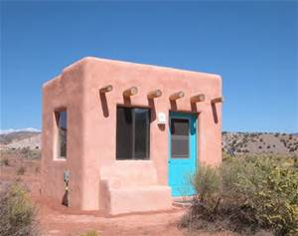
Any method that conserves primary energy because the energy service is provided after the energy is stored, collected, or produced
is called
Energy
Conservation
by
Timing
Notes:
The Adobe Home’s primary architectural element is its clay walls. Thick walls cause heat to take a half a day to pass through. This allows daytime cooling and night-time heating and, as this home suggests, makes electricity-powered heating or cooling unnecessary. The walls thus perform Primary Energy Conservation by timing because they reduce the need for electricity.

Slide 14
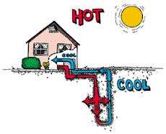

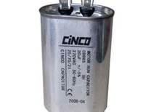
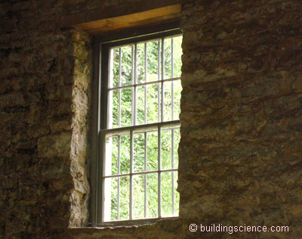
Examples of Timing
Notes:
The run-capacitor moves electricity by a few milliseconds in an electric motor so that voltage and amperage peak simultaneously to maximize the efficiency of the motor.
The ground-coupled heat pump stores heat in the ground during the summer; some of that heat is available to assist winter-time heating. Similarly, heating the home in the winter facilitates cooling in the summer.
Electric batteries reduce primary energy consumption if they consume early morning electricity which has less “carbon content” because it can be expected to have a higher percentage of wind energy than at other times.
The thick masonry wall acts like the clay wall in the adobe home of the previous slide.

Slide 15
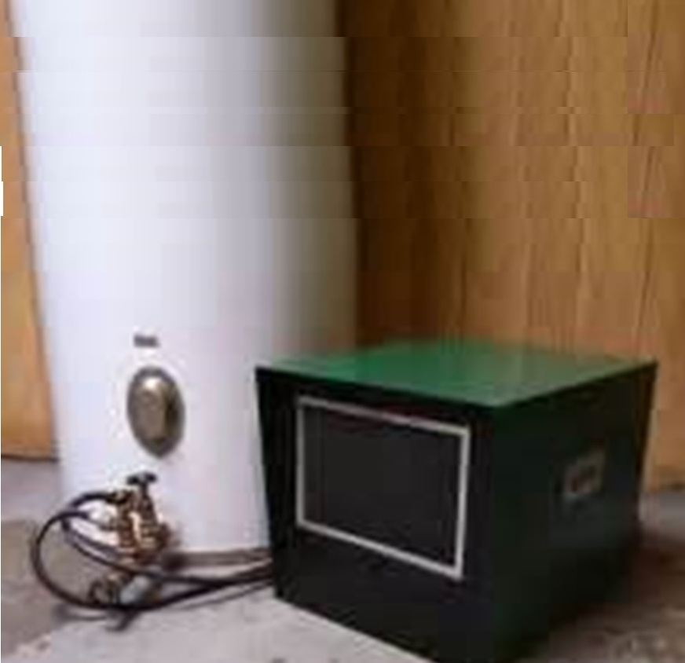
A typical, domestic heat pump water heater runs like a window AC with a ½ ton compressor. It takes about 1.5 hours to reheat 25 gallons of water to
120˚F from
80˚F input.
Notes:
Every standard electric water heater has the potential to accomplish Primary Energy Conservation by timing if they are managed to ensure that most water heating occurs between midnight and 6 AM. This is not feasible with an on-demand water heater.
In this picture, more is going on. The green box is a heat-pump water heater. Although it is electric, it is the most energy efficient way to heat water whether measured in kWh or BTU of equivalent energy or even if measured at the electricity generator. But its high efficiency is not the point of this slide.
A heat pump water heater can also STORE DRYNESS in the wooden objects, walls and floor coverings of the home. This stored energy can be made to help buffer incoming air humidity (whether from ventilation or infiltration) and help maintain a comfortable indoor climate with less applied energy at the real time that comfort is demanded, i.e., hours later than the time the electricity was consumed at the heat pump water heater.

Slide 16
IMPROVE THE ECONOMY WHILE CUTTING CARBON EMISSIONS
Inverted Demand Compliant Construction
Second Part
What is IDCC?
Why is it so defined?
Why does it cost < $0?
Store electricity when it is cheap for use when it is expensive.

Slide 17
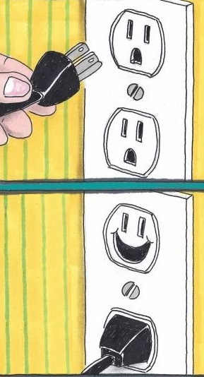
Notes:
This pair of images represent two things: A welcome joke and a concern of the person who hold the plug.
The joke is: the actual appearance of the plug looks like the face of a man in distress because it looks like he will be stuck in both eyes and mouth by the threatening plug. The second image expresses delight in the higher plug that it was not so pierced.
However, there is another interpretation of the two images: Will there be electricity available for the appliance on the other end of the plug? The person holding the plug never really knows until the outlet performs.
Indeed, it is the reliability of the outlets that really interest us, not the reliability of the grid. That’s what IDCC is primarily about.
Besides for the subtle joke in the picture, (always a good way to start a talk), there is another implicit message in the pictures: Will the power get to your appliance? I.e., is your The Power at your OUTLET RELIABLE? In the rest of the talk, I will use the term "Outlet Reliability" to refer to the reliability of power for all end uses in your building including those that are plugged and those that are hardwired: like lighting and air conditioning.

Slide 18
Notes:
This pair of images represent two things: A welcome joke and a concern of the person who hold the plug.
The joke is: the actual appearance of the plug looks like the face of a man in distress because it looks like he will be stuck in both eyes and mouth by the threatening plug. The second image expresses delight in the higher plug that it was not so pierced.
However, there is another interpretation of the two images: Will there be electricity available for the appliance on the other end of the plug? The person holding the plug never really knows until the outlet performs.
Indeed, it is the reliability of the outlets that really interest us, not the reliability of the grid. That’s what IDCC is primarily about.
Besides for the subtle joke in the picture, (always a good way to start a talk), there is another implicit message in the pictures: Will the power get to your appliance? I.e., is your The Power at your OUTLET RELIABLE? In the rest of the talk, I will use the term "Outlet Reliability" to refer to the reliability of power for all end uses in your building including those that are plugged and those that are hardwired: like lighting and air conditioning.

Slide 19
The need for Reliability makes Backup Power economical NOW for many buildings; perhaps those that use most of US electricity.

Slide 20

Fossil-fueled Backup Power Ruled Out
Much more expensive 1/2 as efficient as utility equip
“Eyesore,” weather beaten,
bulky, noisy, hard to maintain
Unreliable equipment & fuel
source
Can be dangerous
No tax subsidy
No benefit if no power outage
No “in-home” energy
conservation incentive
Can’t reduce CO₂

Slide 21
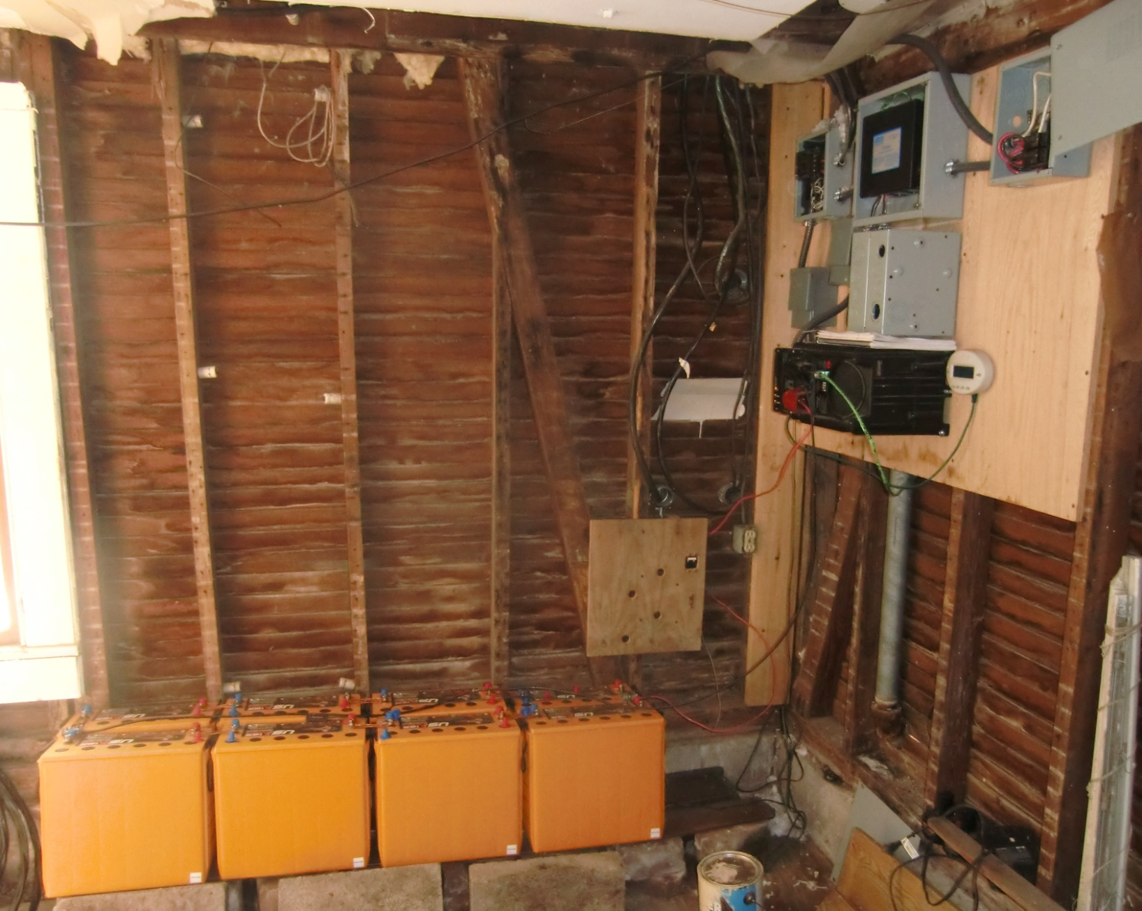
BATTERY BANK & INVERTER / CHARGER
Notes:
Implementing Inverted Demand.
All current buildings can rapidly effect Inverted Demand by installing a battery and inverter/charger system that takes 4 hours to collect all of the energy that a building consumes in 24 hours.

Slide 22
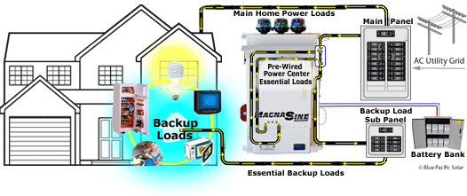
Emergency Backup Mode
Notes:
Roughly, the same amount of energy needed to run a home for day (in an unfettered manner) is sufficient to run the home for a week in Emergency Backup Mode.

Slide 23
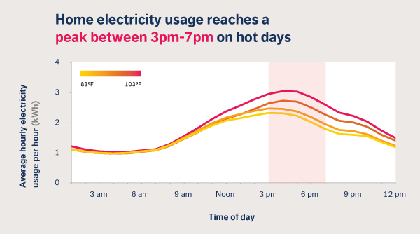
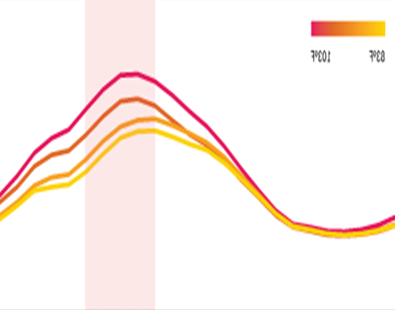
Demand During a Day
Typical Atypical
Notes:
Conceptually, Inverted Demand Compliant Construction (IDCC) means
“Electricity Demand vs Time” of a building is as atypical as possible when compared to most other buildings, and
Demand for electricity by the building and Supply of electricity to the utility is compliant to requests made by the utility or a big brother company.
This slide shows what “inverted demand” means in a theoretical sense… Not how to make that happen.

Slide 24

A Building has Inverted Demand if
it has a battery and
inverter/charger system
which collect energy
during 4 hours in early a.m.
which allow off-grid
operation during the
remaining 20 hours
Notes:
This slide tells you HOW to make more restricted demand than merely inverted demand.. It actually shuts down all demand from the grid for four hours. Ok… maybe more than the name implies, but this is the definition I want.
It is very important that the home gets all of the energy it needs for a day within 4 hours.

Slide 25
An IDCC Building has
Inverted Demand and
it is Compliant to
requests by the remote operator
to decrease demand or supply
electricity.
3. These are called
  Demand Response and
  Supply Response,
  respectively.

Slide 26
Inverted Demand Compliant Construction
Specifies grid-connected, hybrid, battery
backup + full-time power supply,
  Absorbs low-cost, non-dispatchable, renewable energy, and thereby saves $$.
  Improves electricity reliability at lower cost than is projected for refurbishing the grid,
  Pays back better than PV, and
  Produces less CO₂.

Slide 27
Less than $5000 is sufficient.
Inverter / Charger 4 kW $1500
Transformer 4 kW 300
Automatic Transfer Switch 50
8 AGM† Batteries 20 kWh 3000
TOTAL $4850*
†5 year
*Eligible for 80% tax credit
Notes:
Implementing Inverted Demand.
All current buildings can rapidly effect Inverted Demand by installing a battery and inverter/charger system that takes 4 hours to collect all of the energy that a building consumes in 24 hours.

Slide 28
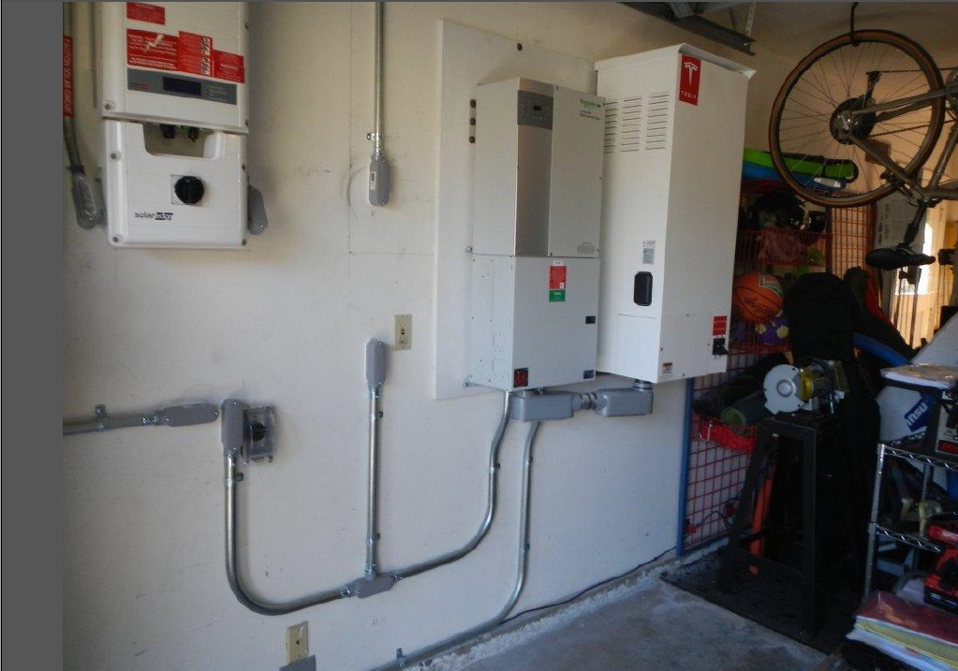
SolarCity’s much Smaller Footprint
B
A
T
T
E
R
Y
Notes:
This is the way Solar City has done something similar. But is for a different design goal and this is a very rare installation. The battery on the wall has about the same functionality and cost as the batteries in my home but it uses Li-Ion technology instead of Pb-Acid. This is much lighter. The battery on the wall is probably one designed for one of Tesla’s electric vehicles. The new Tesla Wall promoted about 8 months ago has apparently not really been sold yet; neither have they published their warranty for this battery type.

Slide 29
What Cash Flow will Support this $5000 Purchase?
The batteries in this example cost $3000 and should last about 5 years under the intended use.
Although 20 kWh is the battery bank’s nominal storage capacity, only 50% depth of discharge is advisable for long economic life. Therefore, 20 kWh works well with a home whose consumption peaks around 10 kWh / day.
A five year payback on $5000 is $1000/year.
Therefore $500 / year pays more than half of what is needed to pay for the recurring costs.

Slide 30
Reliability is worth $520/yr and
Can pay ½ cost of IDCC
Maryland Public Service Commission fines PEPCO $1 million because of poor reliability (12/21/2011)
PEPCO surveys its customers and learns that residents experience $520/year in economic losses from outages
Notes:
How does Reliability Pay for IDCC?
Residential customers are often beset with fear:
Think: Katrina, Sandy, or Polar Vortex.
$1500 to $20,000 estimates damages for
Outages that last a day to a few weeks.
Commercial customers report (recent Pepco data):
Outages are common without storm events; these last a few minutes to a few hours
Cause ~$2000 in damage on average.

Slide 31
Demand Response
Can pay ½ the cost of IDCC
Demand Response means incentive payments from the utility designed to induce lower electricity use at times of high wholesale market prices.
Notes:
What Pays for IDCC Besides Reliability?
Besides for reliability, there are three ways that the utility SHOULD pay you money or give you a retail rate discount because your building helps the grid avoid expensive wholesale electricity.
Demand Response
Supply Response
Frequency Regulation

Slide 32
“A homeowner that has equipped his home to be IDCC should have the right to CLAIM a 25-50% lower price for electricity than other homeowners serviced by the same utility”
-Steven A. Fenrick, 2014
Notes:
Steven Fenrick is the lead economist for Power Systems Engineering--a consulting firm that literally has over 50 utility clients around the world.
This and the next slide are both about demand response. Together, they state that payments by the utility for Demand Response should offset an average homeowner's utility bill by roughly 50%. This income stream is enough to pay about half the cost of a battery backup system.

Slide 33
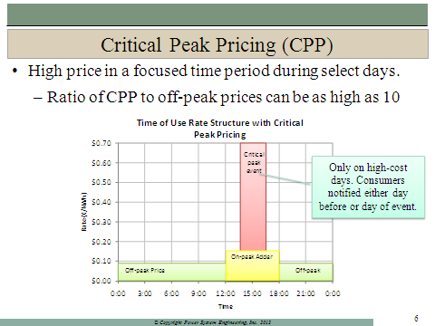

Slide 34
“An IDCC home may be able participate in Critical Peak Pricing with a Time-of-Day rate, known as CPP. If a battery can provide substantial energy during a CPP time, it could drive substantial savings
-- around $100 to $800 per year.”
- Steven A. Fenrick, 2014

Slide 35
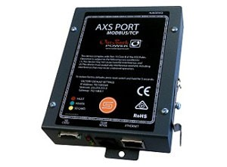
Implementing Supply Response
The addition of a $130, AXS Port Modbus/TCP Interface can upgrade Inverted Demand, to IDCC since it provides “supply response”.
Charging and discharging are put under the REAL-TIME control of the remote operator.
Notes:
When the IDCC talk was first designed, more than 2 years ago, I naively believed that the grid operator would be willing to turn on, off and switch the direction of energy flows to batteries for every home. However, grid operators don't have the bandwidth for such granularity. But, aggregates of homes' battery systems can create a big enough energy moving machine to be worthy of a grid operator. Alas, even that is not likely. The ultimate answer, however, is probably via third party companies who will do the aggregation and control services for a piece of the action.

Slide 36
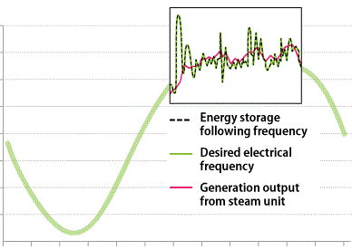
Frequency Regulation
A New Jersey, IDCC building may be allowed to sell this service to their wholesale power market, PJM.
“Regulation” protects electricity frequency.
Per the following V2G example, if IDCC uses an 18 KW inverter/charger and a 24 kWh battery, such a building may receive income at $5/day.
Notes:
Unlike incandescent lamps, fluorescent lamps will make a mess out of an incoming, pure sine wave of electricity. For the residual energy to have good economic value, frequency regulation and probably some voltage support "work" needs to be done to restore the wave to fully useful to the next customer.
The irregular and abused sine wave "blown-up" in the graphic is described to be normal output of a steam generator.
Regardless of the source of these distorted sine waves, the grid will experience them and either they will be cleaned up for a cost or they will degrade or damage equipment that tries to consume that energy.
The utility must either clean it up or pay someone to do. In PJM, this lucrative opportunity is offered as service PJM will buy. The problem is well matched to the capabilities of a battery system.

Slide 37
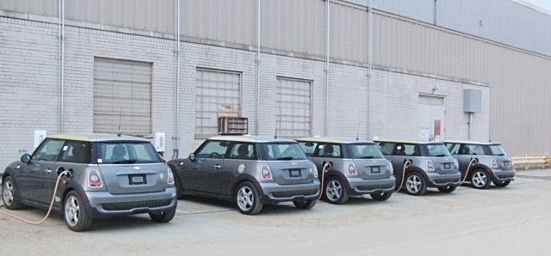
Grid on Wheels of V2G
$5 per car per day paid for Frequency Regulation;
This is much more than ½ the annual payback for IDCC.
Think of cars as batteries
Notes:
Who beside PJM is promoting the purchasing of the Frequency Regulation Service?
FERC’s November 2015, Order 819 Encourages Wholesale Markets to buy Frequency Regulation.
The Federal Energy Regulatory Commission is revising its regulations to foster competition in the sale of primary frequency response service.

Slide 38
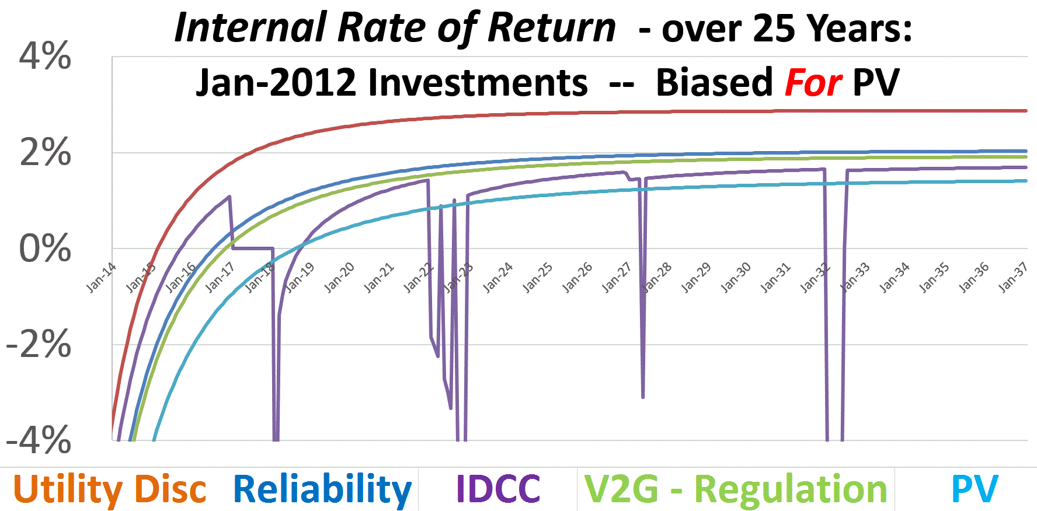
Demand Response
Notes:
Utility Disc means the income from the utility to pay for Demand Response.
Is IDCC is more Economical than PV?
You Betcha!
Using 25-year simulations, BSI found IDCC to have slightly better Internal Rate of Return than Photovoltaics over a wide range of assumptions.
In fact, that "proves" that IDCC costs < $0. This is because
Net Energy Metering costs < $0.
Jon Wellinghoff, past chairman of FERC, knows the value of SE because he explained CPUC’s PV published value of 103% of retail. (These figures do not include any general societal, or environmental benefits.) He pointed out that PV’s effect results in only a 3% net benefit because costs normally (and inappropriately) assigned to residential and commercial customers are 30% too high and NEM avoids much of this imbalance.

Slide 39
Poor Utility ↑Costs, Energy
Design & CO₂
RETAIL→
WHOLESALE→
EFFECTS
Leaky Economy
Grid Defections
Less Outlet Reliability
Poor Building Design
Less Renewables
Less Innovation
Less Retrofits
Stymied Appliance Design
Misallocation of Capital
IS CAUSED BY
Economic Dispatch
Try to be 100% Reliable
Erroneous Retail Prices
Cross-Subsidized Rate Classes
Mistaken Demand Charges
Stuck on Energy Efficiency
Weak Demand Response
Poor Performance Incentives
Won’t Buy Electricity Services
IDCC
CLEP
Notes:
This and the next slide are an orchestrated pair. Their goal is to highlight with words, colors and pictures the facts that poor utility design increases the 1) cost of electricity to retail customers, 2) primary energy used to make that electricity and 3) amount of CO2 generated.
The central graphic is meant to depict a full cone; where the red, central cylinder represents highly restricted wholesale electricity coming in from the left and expensive retail electricity leaving on the right.
The progressively smaller diameter and varied colored discs each depict a restricting cause, if on the left side, or progressively larger diameter effect, if on the right side, of poor utility design.
SAY THIS: Blue colored causes or effects can be ameliorated with IDCC; red with CLEP; purple with either IDCC or CLEP.
The larger diameter, blue cylinder appears in the second slide but not the first slide to indicate that once economic dispatch is abandoned, more wholesale energy flows in which results in less cost.

Slide 40
Good Utility ↓Costs, Energy
Design & CO₂
RETAIL→
WHOLESALE→
EFFECTS
Stronger Economy
No Grid Defections
More Outlet Reliability
Better Building Design
More Renewables
More Innovation
More Retrofits
Advanced Appliance Design
Invest on Demand Side
IS CAUSED BY
Less Economic Dispatch
4-hour Grid Reliability
Smart Retail Prices
Independent Rate Classes
Smart Demand Charges
Reward Timing & EE
Smart Demand Response
Smart Performance Incentives
Buy Electricity Services
IDCC
CLEP
Notes:
This and the next slide are an orchestrated pair. Their goal is to highlight with words, colors and pictures the facts that poor utility design increases the 1) cost of electricity to retail customers, 2) primary energy used to make that electricity and 3) amount of CO2 generated.
The central graphic is meant to depict a full cone; where the central red cylinder represents wholesale electricity coming in from the left and retail electricity leaving on the right.
The progressively larger diameter and varied colored discs each depict a restricting cause (if on the left side) or effect (if on the right side) of poor utility design.
Blue colored causes or effects can be ameliorated with IDCC. Red with CLEP. Purple with both IDCC and CLEP.
The larger diameter, blue cylinder appears in the lower slide but not the upper slide to indicate that once economic dispatch is abandoned, more energy flows at less cost.

Slide 41
IMPROVE THE ECONOMY WHILE CUTTING CARBON EMISSIONS
Inverted Demand Compliant Construction
Second Part
What is IDCC?
Why is it so defined?
Why does it cost < $0?
Store electricity when it is cheap for use when it is expensive.

Slide 42
IMPROVE THE ECONOMY WHILE CUTTING CARBON EMISSIONS
Inverted Demand Compliant Construction
Third Part
Coupled to Evolution in grid design, IDCC greatly improves reliability & lowers cost.

Slide 43
What is Economic Dispatch?
no yes
RETAIL→
WHOLESALE→
Notes:
Think of the conical image of wholesale electricity entering on the left. Note that the various restrictions in various colors restrict electricity flow into the economy (on the right).
The smallest aperture is caused by Economic Dispatch. Since utilities can control fuel fired generation, they can make electricity on demand. Dispatch is the easiest, but most expensive way to deliver electricity.
Dispatch usually excludes cleaner renewable energy. Therefore primarily only more expensive energy flows are used and the economy is jeopardized.

Slide 44
1¢/kWh
1¢/kWh
3¢/kWh
MISO on
09-10-14
@18:10
25¢/kWh
MISO on
09-11-14
@ 01:50
Notes:
MISO is the name of the wholesale marketplace servicing most of Louisiana. It is called the Mid-Continental Independent System Operator because of its central location in North America.
Note that the price of electricity depends upon location and time of day. Just in New Orleans and within 8 hours, the wholesale price of electricity increased six fold from 3 to 25 cents / kWh.
Note the deep blew areas, these are probably all wind farms and must sell at one cent / kWh or less because of locally or temporarily poor demand.
IDCC homes can buy kWh cheap and also improve the economics of wind farms.
Therefore, if RETAIL electricity prices closely track WHOLESALE prices, a great deal of energy can be saved and CO2 avoided.
As long as dispatch dominates the wholesale electricity market, those who finance wind farm installations will continue to get depressed price signals leading to less WIND investment.

Slide 45

BuildingsWithout “Diapers”
We should not be designing buildings that dump demands onto the grid without regard to time-of-day.
We do not want infant buildings; we want mature buildings!
Notes:
Electricity 1.0 is the utility design of the developed world.
It has done a very good job at integrating three things: providing reliable electricity 24/7/365, voltage, and frequency.
That is precisely why, for over 100 years, we have been designing Buildings Without Diapers!

Slide 46
Electricity 1.0 is Today’s Poor Utility Design
Electricity 2.0
Is improved by smart meters,
  micro-grids, independent producers,
Is only responsible for electricity
distribution,
Provides a marketplace for energy
sales between generators and loads,
Allows islands of reliability,
Can migrate rapidly and orderly
into full grid competence.
Electricity 3.0
Is Electricity 2.0 but
Need only have grid reliability,
For four hours a day,
EVERY DAY.
Notes:
Reliability at the outlet vs. Reliability of the grid
Distinguishes Electricity 2.0 from Electricity 1.0.
Electricity 1.0 achieves reliability at the outlet by total reliance on reliability of the grid.
Electricity 2.0 allows reliability of the outlet to be independent of the grid but still attempts to maintain (at a now unnecessarily high cost), the same 24/7/365 reliability of the grid.
Reliability of the outlet is the primary goal.
Less investment in the grid is needed if there is complementary investment in buildings.
It probably costs much less to put diapers on buildings and switch to Electricity 3.0 than to maintain Electricity 1.0.

Slide 47
Put “diapers” on buildings to create a marriage between IDCC and Electricity 3.0
This model can be more rapidly and economically disseminated to the rest of the world because
The developing world already has electricity generation and infrastructure more like Electricity 3.0 than Electricity 2.0 or 1.0

Slide 48
IMPROVE THE ECONOMY WHILE CUTTING CARBON EMISSIONS
Inverted Demand Compliant Construction
Third Part
Taught you
IDCC complements Electricity 3.0
  Creates an evolution in grid design,
  Deemphasizes dispatching power,
  Grid’s job now is to now provide ENERGY
IDCC bldgs provide reliable POWER to their own outlets
IDCC + Electricity 3.0 create an economical + environmentally-friendly pathway for developing countries.

Slide 49
IMPROVE THE ECONOMY WHILE CUTTING CARBON EMISSIONS
Inverted Demand Compliant Construction
Fourth Part
  IDCC enhances renewable energy use
    and PV penetration.
  IDCC is easily exported to the developing world.

Slide 50
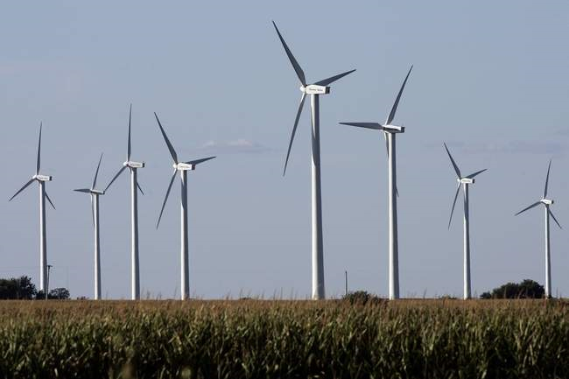

Slide 51
Price/Load Relationship in PJM
Plant operators would rather sell energy at a loss than incur a costly shutdown.
Below Cost Bids
Wind is selling @ < 1¢/kWh
Denholm et. al. 2010
51
Notes:
51

Slide 52
WIND must have a levelized cost below 5¢/kWh to compete in the dispatching, wholesale marketplace and be paid 2.5¢/kWh to earn a profit.
PV can compete in the retail marketplace because it compares to energy priced around 11¢/kWh.

Slide 53
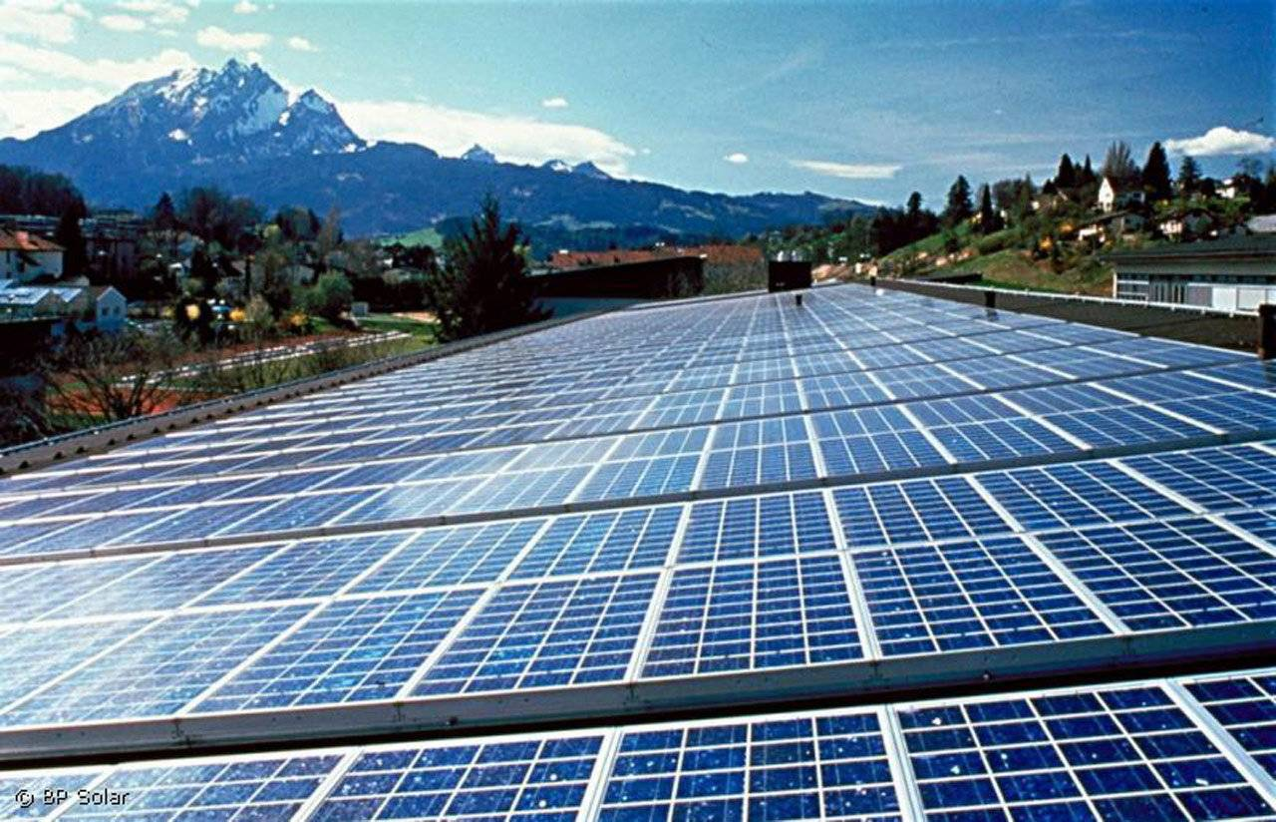

Slide 54
Sustainability Requires Solar Energy
“Within our lifetimes, energy consumption will increase at least two-fold, from our current burn rate of 12.8 TW to 28 – 35 TW by 2050 (TW = 10¹² watts).
This additional energy needed, over the current 12.8 TW energy base, is simply not attainable from long discussed sources – these include nuclear, biomass, wind, geothermal and hydroelectric.”
“… Sunlight is by far the most abundant global carbon-neutral energy resource.”
-- Daniel G. Nocera, MIT

Slide 55
PV has Decreasing Marginal Value
Mills and Wiser (2012)
Notes:
In earlier research, we conducted an analysis of the marginal economic value of PV with increasing penetration levels based on a case study of California in 2030.
Similar trends can be identified in work from others, including both modeling and empirical analysis in Germany.
Here the value is based only on generation investment and fuel costs (we don’t include any impacts to the transmission & distribution system)
We found that the decline in the marginal economic value of PV is primarily due to the drop in capacity value and energy value.
The capacity value falls as the addition of PV shifts the peak net load into early evening (after sunset).
The energy value falls as additional PV begins to displace lower and lower cost fuels (more efficient CCGT’s, coal)
Energy value also declines due to curtailment when conventional generation cannot move lower or it would be too expensive to shut them down if needed shortly thereafter.
Costs associated with short-term variability and uncertainty, on the other hand, do not change as dramatically with increased penetration levels.
In this particular analysis the cost of DA forecast errors and increased ancillary services stayed at about $5/MWh or less.
There are a few studies that calculate these costs for PV in more detail, and they find a similar range of costs.
Again I want to reiterate that we did not look at impacts of PV on distribution systems, so these conclusions are based on the impact of PV on just conventional generation.
What is increasingly clear is that for high PV penetrations a large challenge is going to be low value of additional PV at times when PV generation is already high.
Is there a role for storage in overcoming the challenge of declining economic value of PV?

Slide 56
Curtailed PV - Extreme Case
Denholm and Mehos. 2011
20% Contribution from PV
National Renewable Energy Laboratory Innovation for Our Energy Future
Notes:
56

Slide 57
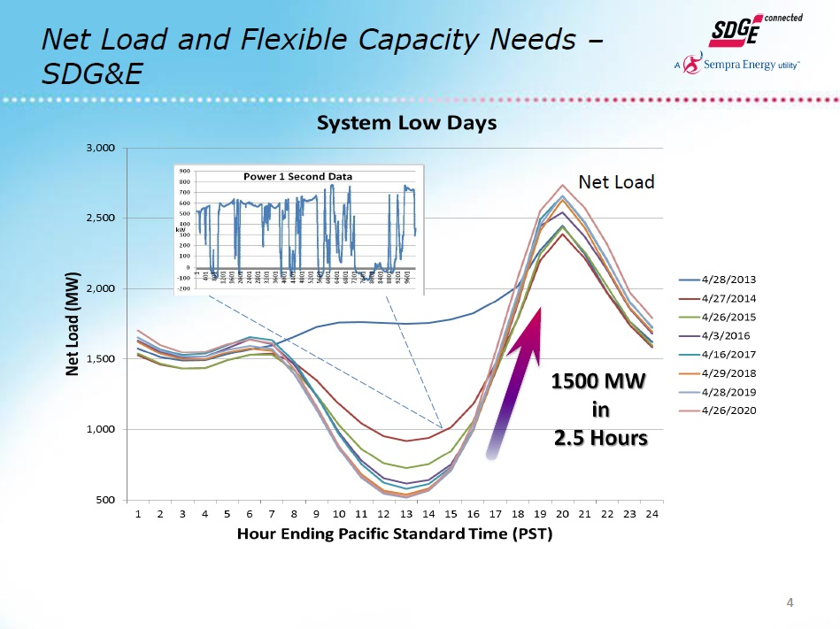

Even Predictable PV Loss Wastes Energy
Bialek, 2014
Notes:
This slide came from the chief of operations of San Diego Gas & Electric. It was within a talk he gave in January of 2014. It depicts his projection of the shape of the load curve in his district into the future on a day in April for consecutive years until 2020.
The only historical data is the blue line. It shows the most recent story: the traditional load curve had already taken this “Duck” shape from what had been the common gradual rise to a peak around 5 PM and then faster, but steady decline over the next couple hours.
The third reviewer of this slide show pointed out that the image didn’t show us enough history: he wanted to know what the demand curve looked like before PV penetration was more than negligible. For that reason, I added a segment of a sine curve onto the slide which appears in red—spanning 10 AM to after 6 PM. It think that is a good guess at the historic demand curve before PV.
The real issue he was discussing is the need to accelerate the rate at which peaking capacity must be brought on-line as the sun sets. He projects that both the total amount of supply capacity needed to be switched on and the rate at which this capacity must be activated will grossly increase in the very near future.
THE SOLUTION is the Electricity Service called “Spinning Reserve”, a.k.a., “Voltage Support”. In this talk, I call it Supply Response.
New Orleans sits at the far end of MISO and it’s lone power plant, Michoud, is about to be permanently shut down. Michoud provided expensive Spinning Reserve. Germany uses very diry coal plants to provide spinning reserve to back up the deep penetration of PV that produces highly fluctuating supply in response to the passage of clouds. These back-up system grossly undermine the cost-effectiveness of PV.
Only batteries can support PV in ways that only modestly undermine PV value.

Slide 58
Low-cost Storage Can Mitigate the
Decline in the Value of PV
Mills and Wiser (forthcoming)
Notes:
The increased charging load during times when PV generation would otherwise be displacing low cost fuels leads to an increase in the value of PV at high penetration levels when storage costs are low.
We (DOE RESEARCHERS : Mills and Wiser) measured the increase in the value of PV with the availability of low cost storage; by comparing the difference between the value of PV when storage was expensive (our Reference scenario) to when we assumed a much lower cost.
In summary, what is the role of storage in overcoming the economic challenges of getting to high PV penetration?
Not much if storage is expensive,
But if storage is low cost, then you build more storage in high PV penetrations and the marginal value of PV is increased. Higher marginal value helps to get to higher PV penetrations.

Slide 59
Grid-Controlled Storage is Better for PV
Cost or
Value
Cost of PV + Cost of Storage
Cost of Integrated PV/Storage
Value of PV + Value of Storage
Value of Integrated PV/Storage
(if storage not dispatched based on system needs)
PV penetration level (% Annual Load)
Mills
Notes:
Even with integrated PV and storage, you still want that storage to be dispatched based upon system needs. If it is not dispatched based on system needs then you could imagine the value of integrated PV/storage actually being less then the value of an independent storage and independent PV facility.
Two situations where the value of integrated PV/storage could be lower than if they were independent assets:
First: the value might be lower if the integrated storage is used to smooth PV at that single site when actual system needs would dispatch the storage differently.
Second: If storage is used to minimize a customers utility bill when retail rates are not necessarily perfectly aligned with system needs.
This is an issue with proper rate design: how do you align the incentives of a customer who adds storage such that when a customer dispatches storage to minimize her electricity bill that also provides the maximum value to the system?

Slide 60
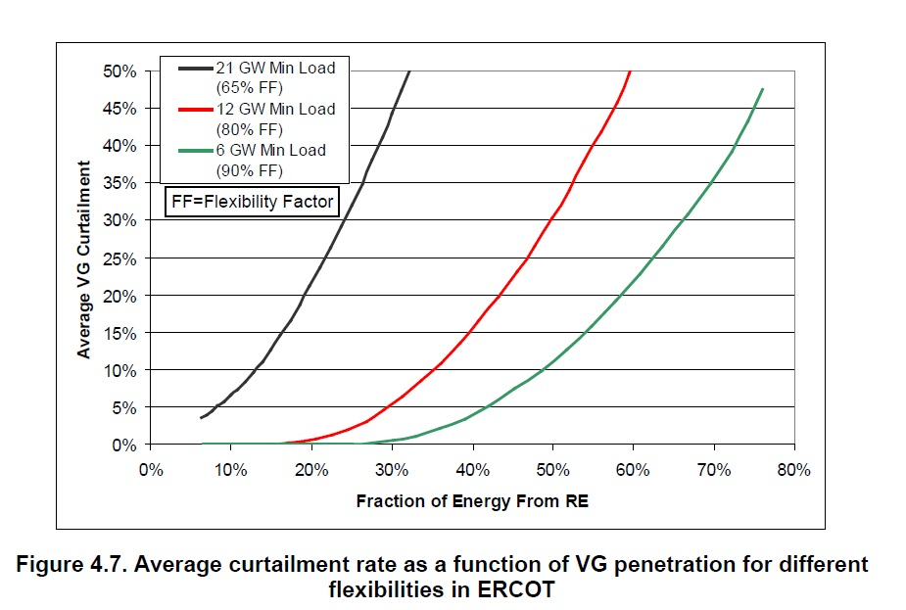
Curtailment is Flexibility Dependent
Curtailment
decreases with
increasing
number of
smaller supply
resources.
Denholm et. al. 2010
Notes:
If a utility’s supply assets are limited to a small number of large (21 GW) power plants, PV penetration as low 7% can experience limited curtailment.
If a utility’s supply assets are limited to a larger number of medium sized (12 GW) power plants, PV penetration as low 18% can experience very limited curtailment.
If a utility’s supply assets are limited to an even larger number of small (6 GW) power plants, PV penetration as low 27% can experience limited curtailment.
This strongly implies that as the generators that can be remotely dispatched increases in number of separately dispatched sources and decreases in size, the critical curtailment effect can be put off to much higher PV penetration.
If this the case, IDCC can solve the PV penetration problem as soon as IDCC is widely adopted within a utility district.

Slide 61
What does all of this mean?
To get a renewable energy future, we need much more Solar Energy.
To get there, we may need a lot of batteries installed on the grid.
They should be controlled by the utility grid operator as opposed to the customer.

Slide 62
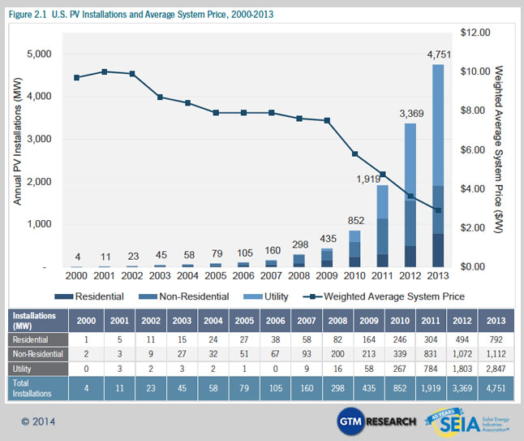
.
14 years of US PV Installations, 2000 - 2013
Notes:
Although greatly impeded by Electricity 1.0, Non-Dispatachable renewable energy is rapidly penetrating the grid.
Electricity 2.0 or 3.0 will speed this up because these “better utility designs” will help to avoid the many predicted roadblocks to renewable energy described in this part of this talk.
The best team to allow maximum renewable energy penetration into the future is IDCC and Electricity 3.0.
Electric utilities are very concerned about the mandate to absorb non-dispatchable electricity from PV because, for the reasons stated above, PV shifts more and more costs onto the utility.
IDCC ameliorates these problems substantially, but teamed up with Electricity 3.0, they provide a light at the end of the tunnel for a future where high PV penetration can be a win-win-win.

Slide 63
IDCC is Readily Adaptable to the Developing World
Installation only requires about $5000 of hardware + very minimal electrical contractor skills.
Lack of significant transmission infrastructure is a much bigger problem for Electricity 1.0 than Electricity 3.0.

Slide 64
IMPROVE THE ECONOMY WHILE CUTTING CARBON EMISSIONS
Inverted Demand Compliant Construction
Fourth Part
Taught you that IDCC (with or without Electricity 3.0)
  Improves reliability,
  Reduces CO₂ production,
  Enhances renewable energy penetration,
  Lowers the cost of electricity, and
  Is easily exported to developed and developing world.

Slide 65
Talk Summary:
IMPROVE THE ECONOMY WHILE CUTTING CARBON EMISSIONS
Inverted Demand Compliant Construction (IDCC)
Good Utility Design avoids 25% of Carbon Emissions.
What is IDCC? Why is it so defined? & Why does it cost < $0?
Coupled to Evolution in grid design, IDCC greatly improves
reliability & lowers cost.
IDCC enhances renewable energy use + PV penetration + is
easily exported to the developing world.

Slide 66
Myron Katz, PhD
Energy Conservation, Moisture and Building Scientist
Building Science Innovators, LLC
302 Walnut St
New Orleans, La 70118
Myron.Katz@EnergyRater.com
Notes:
66

Slide 67
IDCC TALK stops here.

Slide 68
Poor Utility ↑Costs, Energy
Design & CO₂
RETAIL→
WHOLESALE→
EFFECTS
Leaky Economy
Grid Defections
Less Outlet Reliability
Poor Building Design
Less Renewables
Less Innovation
Less Retrofits
Stymied Appliance Design
Misallocation of Capital
IS CAUSED BY
Economic Dispatch
Try to be 100% Reliable
Erroneous Retail Prices
Cross-Subsidized Rate Classes
Mistaken Demand Charges
Stuck on Energy Efficiency
Weak Demand Response
Poor Performance Incentives
Won’t Buy Electricity Services
IDCC
CLEP
Notes:
This and the next slide are an orchestrated pair. Their goal is to highlight with words, colors and pictures the facts that poor utility design increases the 1) cost of electricity to retail customers, 2) primary energy used to make that electricity and 3) amount of CO2 generated.
The central graphic is meant to depict a full cone; where the red, central cylinder represents highly restricted wholesale electricity coming in from the left and expensive retail electricity leaving on the right.
The progressively smaller diameter and varied colored discs each depict a restricting cause, if on the left side, or progressively larger diameter effect, if on the right side, of poor utility design.
SAY THIS: Blue colored causes or effects can be ameliorated with IDCC; red with CLEP; purple with either IDCC or CLEP.
The larger diameter, blue cylinder appears in the second slide but not the first slide to indicate that once economic dispatch is abandoned, more wholesale energy flows in which results in less cost.

Slide 69
Good Utility ↓Costs, Energy
Design & CO₂
RETAIL→
WHOLESALE→
EFFECTS
Stronger Economy
No Grid Defections
More Outlet Reliability
Better Building Design
More Renewables
More Innovation
More Retrofits
Advanced Appliance Design
Invest on Demand Side
IS CAUSED BY
Less Economic Dispatch
4-hour Grid Reliability
Smart Retail Prices
Independent Rate Classes
Smart Demand Charges
Reward Timing & EE
Smart Demand Response
Smart Performance Incentives
Buy Electricity Services
IDCC
CLEP
Notes:
This and the next slide are an orchestrated pair. Their goal is to highlight with words, colors and pictures the facts that poor utility design increases the 1) cost of electricity to retail customers, 2) primary energy used to make that electricity and 3) amount of CO2 generated.
The central graphic is meant to depict a full cone; where the central red cylinder represents wholesale electricity coming in from the left and retail electricity leaving on the right.
The progressively larger diameter and varied colored discs each depict a restricting cause (if on the left side) or effect (if on the right side) of poor utility design.
Blue colored causes or effects can be ameliorated with IDCC. Red with CLEP. Purple with both IDCC and CLEP.
The larger diameter, blue cylinder appears in the lower slide but not the upper slide to indicate that once economic dispatch is abandoned, more energy flows at less cost.

Slide 70
Improve the Economy while Cutting Carbon
Part 2.
Costumer Lowered Electricity Price

Slide 71
Myron Katz, PhD
See www.facebook.com/Customer-Lowered-Electricity-Price-CLEP-968877309871636/ for an earlier description of CLEP
Energy Conservation, Moisture and Building Scientist
Building Science Innovators, LLC
302 Walnut St
New Orleans, La 70118
Myron.Katz@
EnergyRater.com
Notes:
71
Google “Facebook CLEP” to find this link most easily.

Slide 72
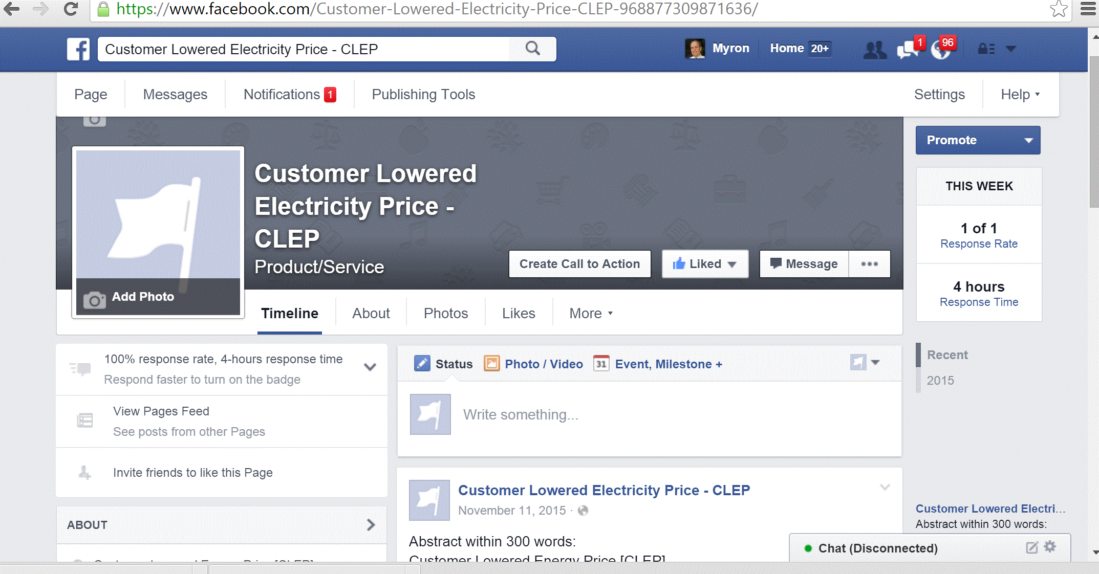

Slide 73
Talk Outline:
IMPROVE THE ECONOMY WHILE CUTTING CARBON EMISSIONS
Part 2. Customer-Lowered Electricity Price (CLEP)
  Good Utility Design avoids 25% of US’s Carbon Emissions
  CLEP can significantly improve utility design
  What is CLEP? Why is it so defined?
  & Why does it cost < $0?
  CLEP in action with worked examples
  Benefits of CLEP
Notes:
The first part of the talk will present a string of implications that logically conclude that poor utility design helps to cause global warming and that CLEP can really improve utility design.
Although specified by two quite simple formulas, CLEP has a complex backstory of rationales and effects. But, because of careful choice of parameters and testing, CLEP performs almost identically to Net Energy Metering and therefore cost < $0.
Not until you see CLEP in action do you really just begin to appreciate the rich economic opportunities it provides. But, the novice should beware, subtle mistakes are easy to make.
Once we trudge through the examples, the benefits of CLEP become immediately obvious. But the benefits form a richer set then the short list presented.

Slide 74
Good Utility Design Reduces ¼ of US’s Carbon Emissions
Optimal Utility Design minimizes the cost to get Electricity
High Electricity Price is Highly Correlated with High Carbon Content
Electricity Generators Produce 29% of US’s Carbon Emissions
Therefore, reducing ¼ of US’s CO₂’s Emissions does not negatively impact the economy; just the opposite is true.
The rest of this talk will show that for no net cost, IDCC can greatly improve utility design in just this way.

Slide 75
Electricity Generators
Produce 29% of
US’s CO₂ Emissions

Slide 76
Wholesale Electricity Price is
Highly Correlated to
Carbon Content
Notes:
This slide shows that the wholesale price of electricity is strongly correlated with the amount of carbon released in its production and delivery. Thus, one easy way to grossly reduce CO2 production is to work hard to get our utilities to buy the cheapest wholesale electricity.
Who would be against that?

Slide 77
What is Economic Dispatch?
no yes
Notes:
Think of the conical image of wholesale electricity entering on the left. Note that the various restrictions in various colors restrict electricity flow into the economy (on the right).
The smallest aperture is caused by Economic Dispatch. Since utilities can control fuel fired generation, they can make electricity on demand. Dispatch is the easiest, but most expensive way to make electricity.
Dispatch usually excludes cleaner renewable energy. Therefore only more expensive energy flows are used and the economy is jeopardized.

Slide 78
1¢/kWh
1¢/kWh
3¢/kWh
MISO on
09-10-14
@18:10
25¢/kWh
MISO on
09-11-14
@ 01:50
Notes:
MISO is the name of the wholesale marketplace servicing most of Louisiana. It is called the Mid-Continental Independent System Operator because of its central location in North America.
Note that the wholesale price of electricity depends upon location and time of day. Just in New Orleans and within 8 hours, the wholesale price of electricity decreased six-fold from 25 to 3 cents / kWh.
Note the deep blue areas, these are probably all rich in wind farms who must sell at one cent / kWh or less because of locally or temporarily poor demand.
IDCC homes can buy cheap kWh's and in so doing improve the economics of wind farms.
Therefore, if RETAIL electricity prices closely tracks WHOLESALE prices, a great deal of energy can be saved and CO2 avoided.
As long as dispatch dominates the wholesale electricity market, those who finance wind farm installations will continue to get depressed price signals -- leading to less WIND farm investment.

Slide 79
Change tracks by switching the goal from Energy Efficiency (using fewer kWh) to Primary Energy Conservation (generating less CO₂)
Notes:
Don’t measure success at the electric meter, but instead measure it in lbs of CO2 generated. The next slide provides the concept of how to do that.

Slide 80
Any method that conserves primary energy because the energy service is provided after the energy is stored, collected or produced
is called
Energy
Conservation
by
Timing

Slide 81
Timing

Slide 82
IMPROVE THE ECONOMY WHILE CUTTING CARBON EMISSIONS
Customer Lowered Electricity Price
Second Part
    What is CLEP?
    Why is it called CLEP?
    Why is it so defined?
    CLEP costs < $0
Notes:
Customer Lowered Energy Price [CLEP]
rewards decreases in average demand during peak hours;
is a dynamic Time-of-Use pricing tariff that also pays for sales of power
provides retail prices which accurately exploit highly fluctuating, wholesale prices.
provides an optional, additional, economic relationship between a utility customer and his electricity utility; i.e., does not replace the retail RATE or customer class.
accumulates kWh transaction credits (or charges) every 5 minutes WITH monthly KW credits INTO a monthly payment;
lowers the future cost of electricity to all customers — whether or not a CLEP customer;
avoids the need to impose time-of-use rates onto any customer while providing many or more of TOUR’s benefits;
provides a superior kind of demand response @ no cost;
creates a reliable cash flow sufficient to support battery installs in any building & pays as well as Net Energy Metering.
provides a market-based tool to harvest off and off-off peak power, from any source, for peak power use;
grossly forestalls grid defection and thereby helps to insure the long-term economic life of a utility;
forestalls the need to invest in expensive, less efficient or not well-utilized, peaking plants;
enhances Energy Performance Contracting, Demand Side Management and continuous Integrated Resource Planning;
makes battery backup far more cost-effective than locally installed, and far less reliable, micro, gas-fired generators;
provides an opportunity for a big payback for smart meters;
taps into, Primary Energy Conservation by Timing, the richest source of dollar paybacks as well as energy savings;
revolutionizes the whole concept of building energy design; and
Engages market forces’ simply pursuit of economic self-interest to rapidly decrease the causes of global warming.

Slide 83
What is CLEP?
Customer Lowered Electricity Price (CLEP) is a dynamic pricing tariff that allows purchases and sales of electricity at wholesale prices + rewards drops in average demand during peak demand periods.
With this tariff, every kWh that passes through the meter actually lowers future electricity prices for all customers.
Notes:
Customer Lowered Energy Price [CLEP]
rewards decreases in average demand during peak hours;
is a dynamic Time-of-Use pricing tariff that also pays for sales of power
provides retail prices which accurately exploit highly fluctuating, wholesale prices.
provides an optional, additional, economic relationship between a utility customer and his electricity utility; i.e., does not replace the retail RATE or customer class.
accumulates kWh transaction credits (or charges) every 5 minutes WITH monthly KW credits INTO a monthly payment;
lowers the future cost of electricity to all customers — whether or not a CLEP customer;
avoids the need to impose time-of-use rates onto any customer while providing many or more of TOUR’s benefits;
provides a superior kind of demand response @ no cost;
creates a reliable cash flow sufficient to support battery installs in any building & pays as well as Net Energy Metering.
provides a market-based tool to harvest off and off-off peak power, from any source, for peak power use;
grossly forestalls grid defection and thereby helps to insure the long-term economic life of a utility;
forestalls the need to invest in expensive, less efficient or not well-utilized, peaking plants;
enhances Energy Performance Contracting, Demand Side Management and continuous Integrated Resource Planning;
makes battery backup far more cost-effective than locally installed, and far less reliable, micro, gas-fired generators;
provides an opportunity for a big payback for smart meters;
taps into, Primary Energy Conservation by Timing, the richest source of dollar paybacks as well as energy savings;
revolutionizes the whole concept of building energy design; and
Engages market forces’ simple pursuit of economic self-interest to rapidly decrease the causes of global warming.

Slide 84
A Monthly CLEP Payment = CLEPm + ∑ CLEP5
Where: CLEP5 = p * n * (e - w) is calculated every 5 minutes
p = Utility/regulator determined, “percent” and 0 < p < 2;
n = Number of kWh purchased by the customer.
If the flow is outbound (i.e., a sale), n is negative;
w Wholesale cost of power
e = Monthly/average cost of energy (fuel cost adjustment)
Where: CLEPm = q * $50 * d
d = Average demand during peak hours avoided (that is: d =
observed reference building demand minus observed demand)
q = Utility/regulator determined “percent” and 0 < q < 2.
Notes:
Notes: 1) For Entergy, ISO means MISO. For a utility in Maryland, ISO means PJM, etc. All ISO’s designate the 5-minute time periods as starting on the hour or after any multiple of 5-minutes thereafter. If w were defined to be the ISO, real time, 5-minute price of electricity, during most months of any year, the average value of w over a month should be only slightly higher than e. When the utility’s marginal cost of electricity is different than the ISO price, a CLEP purchase uses the lower price; a CLEP sale uses the higher price.
2) Since CLEP₅ is calculated 12 times an hour, a monthly aggregation of CLEP₅ payment to a customer is the sum of roughly 12 x 24 x 30 such addends.
3) A “standard”, monthly electric bill is well approximated by N * Price/kWh = N * (s + e), where s is the average “cost of service” and e is the average marginal cost of electricity (whether generated by the utility or purchased from the wholesale marketplace) and N is the sum of the n’s for each of the 12x24x30, 5-minute time periods corresponding to a monthly bill.
4) When p = 1, CLEP measures the “benefit” of an off-peak electricity purchase (or an on-peak electricity sale). If p < 1, CLEP is shared with customers who are not a party to the kWh purchase by the CLEP customer: non CLEP customers receive their benefit the next time e is calculated because e is lowered by every positive CLEP transaction. HENCE the name: CLEP; such transactions lower the cost and thus the price of electricity for all customers during the next month. One can posit reasons why a regulator may want to set p = 2 at first and then let p slowly decline to around 90% over 5 years.
5) CLEP is an optional, additional tariff that is open to all customers of a utility—much the same way Net Energy Metering is an optional additional economic relationship a customer may choose to have with his utility.
Where d = average demand during peak hours avoided; d = observed reference building demand – observed demand.
Notes:
CLEP_{m} is available as an income stream to all customers whether or not that customer pays a demand charge.
A home connected to a well-configured and controlled battery and/or PV system can have a negative, average demand during peak hours avoided; thus, CLEP_{m} can reward such a system with a substantial payment for the power in addition to the energy it provides.
d = observed reference building demand — observed target building’s demand, for any specific month when CLEP_{m} is paid. The following explains this.
(Just like HERS software has a reference home, every target building can have a reference building, i.e., which can be used to “predict” how such a target building would perform according to some normalizing standard; one such standard is current building code; that can be a good standard against a new home’s construction; HERS software uses this to calculate a Home Energy Rating. Performance according to current building code is not the best choice for CLEP because the home cannot be new—it may be anywhere from one month to over 150 years old. Moreover, because most homes probably have been retrofitted to way better than the building code (if any) or common construction practices around at the time of construction of the target home but still way poorer than current building code, it is neither fair to assume the current code for a substantially older home, nor to assume the comparisons should only be made to homes that have not been improved since new. The optimally fair reference for a building’s average peak demand should be obtained by averaging real, observed data for real existing buildings in any utility district for that month from the set of buildings of the same type as the target building. Although most buildings in any type have probably been retrofitted with electrical, heating, cooling, water heating, and lighting equipment etc. or insulation since it was new; that information should not be cataloged and it is purposefully deemed to be irrelevant for the purposes of CLEP.)
Each target building’s original structure is the only information needed; its condition when it was new determines its building type which includes other, readily-determined information like: age, location, building code or standard building-practices used at the time of construction, number of bedrooms, framing system, etc. For target buildings built after the advent of building codes, all target buildings will be compared to buildings originally built to roughly, barely code-compliant under the building code of that time. The CLEP_{m} benefit will be determined using the difference between real measurements made each month: for each home type, an average peak demand / square feet of conditioned area will be calculated; this will provide the information needed for the calculation of d, i.e., the demand of the reference building needed for the subtraction.
Homes or buildings wishing to gain access to the CLEP tariff must engage a third-party building performance consultant to determine: 1) the type of home that should be used for reference, 2) the area of conditioned space and 2) for target buildings built after the advent of building codes, only buildings originally built to minimum code will be considered appropriate for comparison.
The p used for CLEP_{m} need not be the same value used for CLEP₅.

Slide 85

Mind Your P’s and Q’s
Notes:
This puts the regulator in the position to rapidly adjust the economics of CLEP by changing the p’s and q’s to either accelerate the market or slow down the payments according situations or opportunities that arise.

Slide 86
Why was CLEPm added to CLEP?
&
How should CLEPm be defined?
CLEP5 can’t support a Timing Retrofit’s expensive batteries
CLEPm generates benefits roughly 10 times that of CLEP5
What was intended to supplement has become the main event
The challenges to defining CLEPm were:
  How do you define “KW of AVOIDED demand”?
  What factor of “number of KW avoided” should be used?

Slide 87
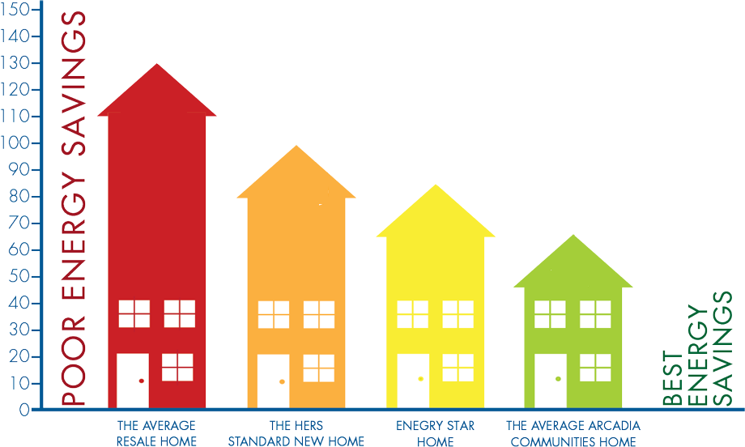
d = Observed reference building average demand in peak hours
— Observed target building average demand in peak hours
for any specific month when CLEPm is paid.
        Each target building’s original structure is the only
        info needed to determine the Reference Building.
        The target building’s condition when it
        was new determines its
        Reference
        Building
        type.
1950
1985
2000
2010
This is test message.

Slide 88
What are the kinds of costs that can be avoided with CLEPm?
What is the minimum cost of a new Combustion Turbine power plant that a utility might have to buy today to meet demand? ANSWER: 200 MW for $175 M
What does that cost the average consumer? (Assuming that roughly 12 billion kWh / year are sold by ENO.) If amortized like a 30-year, home loan, the debt service is roughly $1M / month. There’s roughly 1 B kWh/month sold; therefore the cost / kWh is roughly $0.001 /kWh. Per customer, this amounts to around $1/month for 30 years and the present value of these payments is around $200 to $300 (depending on the discount rate.)

Slide 89
  Why does “$50” multiply “number of KW avoided” in the definition of CLEPm?
For most buildings, conventional peak demand occurs during the utility’s peak hours
For most buildings, AC equipment is usually running during peak demand times and usually dominates demand at those times
AC equipment usually runs 20 to 30 minutes / hour
Therefore the charge for average demand during peak hours should be twice the charge for peak demand during peak hours.
$25/month was recommended by Stephen Fenrick to be optimal for standard, 15-min, demand-charge pricing anywhere in the US

Slide 90

2 more slides:
One on CLEP5
One on CLEPm
questions

Slide 91
IMPROVE THE ECONOMY WHILE CUTTING CARBON EMISSIONS
Customer Lowered Electricity Price
Third Part
CLEP in action with worked examples

Slide 92
Example Assumptions
The target home uses 10,800 kWh/yr or $1080 of electricity @ $0.10/kWh. This is 900 kWh/month so daily needs are 30 kWh. Both the reference home and target home have an average demand during peak times of 5KW.
Respecting current battery technology and our design plan, we should only discharge batteries to 50% to get them to last 10 years. The smallest increment in battery size is 10 kWh, costing $3000. An inverter costs $1500.
Although we recommend p = q = 95%, we’ll assume 100%
Utility Peak Demand occurs @ 3 – 7 PM, M - F, May – Sept

Slide 93
First Example: Give this home Inverted Demand, i.e.,
EARLY AM CHARGING SUFFICIENT FOR OFF-GRID THE REST OF DAY
Back-up: 1 inverter + 6 batteries. Cost: $1.5K + 6 * $3K = $19.5K
CLEP5 = p * n (e - i) = 100% * 900 * ($0.03- $0.02) = $9 => $63 /yr
CLEPm = q * $50 * d = 100% * $50 * 5 = $250/m => $1250 / yr
CLEP = CLEP5 + CLEPm = $1313 / yr
Why use CLEP + only pursue INVERTED DEMAND? Answer: $520 / yr
Value from avoided losses from poor reliability. [Citation in IDCC talk.]
CLEP + $520 = $1833 discount on $1080/yr bill.
This generates a cash flow against an $19,500 investment of $1833/yr with simple payback (without interest) of 10.6 years. ☹

Slide 94
Examples |  | CLEP5 |  |  |  | CLEPm |  | Batteries |  | Back-up | Pay Back | Income Annual
# | Description | Pur-chases |  | Sales |  | Demand Savings |  | Size | Price | Bene-fit
 |  | MWh | $/ yr | MWh | $/ yr | KW | $/yr | kWh | $ 1000 | $/yr | years | $/yr
A | IDCC | 10.8 | 63 |  |  | 5 | 1250 | 60 | 19.5 | 520 | 10.6 | 1833
B | EE Ret | 5.4 | 32 | 0.6 | 30 | 6 | 1500 | 30 | 10.5 | 520 | 5.0 | 2082
C | 5KW PV | 1.2 | 12 | 2 | 220 | 7.5 | 1875 | 30 | 10.5 | 520 | 4.0 | 2627
D | 5KW PV | 1.2 | 12 | 0.8 | 150 | 3 | 750 |  |  |  |  | 912
E | F, WH & DW | .52 | 5.2 | .52 | 5.2 | .8 | 188 |  | 0.6 |  | 3.0 | 198
F
G
H
Notes:
All examples assume the same home: Target home uses 10,800 kWh/yr and has a reference home that has an average demand during peak times of 5KW and the target’s home actually has a 5 KW average demand at peak hours from its equipment .
Since it is IDCC, nothing is sent back to the grid. Since ENO’s FCA is currently $0.03/kWh = minimum price of electricity from MISO during peak demand months, an average CLEP5 payment of about 1 cent/kWh accrues to slightly 7/12 of the energy purchased. Total CLEP5 payments = $63. Total CLEPm payments made for only 5 months, because only cooling season months experience peak demand times. 5 [months] * 5 [KW of average demand saved] * $50 [/KW saved] = $1250. Since IDCC protects Outlet reliability, $520 is also earned. 63+125+520=1833.
An Energy Efficiency Retrofit is performed after which the example only tries to buy a minimum amount of batteries for IDCC. The retrofit results in the energy consumption from A cut in half and the average demand during peak hours reduced by 3/5. However, the battery bank is about 10% too big, this leaves enough energy to fund sales to power 1 kW during all hours of demand during the 5 month cooling season. Since these 600 kWh sales mostly occur at peak times, CLEP5 pays well: at 5 cents/kWh. CLEP5 sales earn $30, CLEP5 purchases earn $32, CLEPm pays at the 6 KW of saved average demand at peak times = 6 * 5 * $50 = $1500 / yr; Backup benefit is earned as well: $32+30+1500+620=$2082.
The following three paragraphs refer to data rows that were excised from the table
This example naively assumes that a 10 kWh battery purchase might be best utilized strictly for Price Arbitrage, i.e., for buying cheap and selling high and ignores what that does to CLEPm. That’s why CLEPm is set to zero. The resulting sum of addends are $70, $42,0,0 = $112 of total annual income.
However, when the energy flow during peak hours are recognized, low and beyond, a full 3 KW of average demand is avoided. This generates a whopping $750 CLEPm payment and even causes the payback for batteries to be next to lowest: 5.2 years. This means, that the same retrofit but without careful appreciation of the consequences of all actions can drastically affect the CLEP income and the payback on batteries.
This retrofit has the 2nd biggest annual income, i.e., $2632 and therefore might seem to be the best use of funds. But that is naïve because, the reader should presume that the batteries will have lost all of their useful life after ten years. So since the during 11.3 of those years, you’re still paying for batteries, the net income is negative. This example is a simple combination Examples A and D. The design idea was to buy enough batteries for IDCC and an extra 10 kWh to see what you can do with all of that storage to maximize yearly income. The results were $70, $42, $1500, $520 = $2132. Just like examples C & D, 12 MWh were purchased for the home, but only a 7/12 of this generated any net income and all at $0.01/kWh during off peak months because of the low FCA of ENO of $0.03/kWh. The same CLEP5 sales happened during peak hours as in D, resulting in $42. The main cash flow came from the 8 KW of avoided average demand at peak hours: this came from the No use of any energy during peak hours because of IDCC which provided 5 KW added to the 3 KW of peak hour sales described in D. 8 * 5 * $50 = $2000.
The next three rows are still in the table.
This is the first of two examples that assume 5KW of PV. Unlike the next one, this one includes a battery purchase. The size of the battery was chosen to allow all off peak PV generation to be moved to peak hours in order to maximize CLEPm. Since 5KW was the PV size, 5 KW was the avoidable average demand at peak times, and the equipment in the home normally generates 5 KW of average demand at peak hours, it may seem that it will take almost 100% of the PV’s output to extinguish that demand. However, since PV systems installed in New Orleans have an average of 5 hours of energy production (at rated power) during the year and we’re talking about the cooling season, it is fair to assume that the PV system will generate 6 hours of rated power output during the cooling season. Moreover, peak demand hours are generally between 3 PM and 7 PM; namely a 4 hour period, this means that roughly 50% more energy will be generated than is needed to extinguish the demand of the home’s AC systems. 20 kWh is all that is needed to send 5 KW for 4 hours. So the remaining 10 kWh can be used to sell to the grid in excess of the home’s AC load; this is equivalent to 2.5 KW of average demand at peak times. The system gets the $520 reliability bonus even though it does not have enough batteries to invert demand because on most days, the PV system will keep up charging the batteries as fast as the energy is consumed in emergency mode.
This is 5 KW of PV with no batteries. This is just PV alone. The PV system can be expected produce 5 KW throughout 80% of the time the AC is on but will not be available to make electricity after sunset. That is why only 3/5 of the demand during peak hours is offset by the PV system. Sum of all addends is $912. This value is almost identical to the output if Net Energy Metering tariff is used instead.
In this case, a Fridge, Water Heater and Dishwasher are purposely set to be fully off during peak hours. This does not require batteries except for the Fridge: Most modern dishwashers have delay-start settings; therefore for a DW there is no capital cost. A Water Heater only needs a timer that turns it off for 4 hours. The big challenge is for the Refrigerator. It’s food in the freezer cannot really tolerate uncontrolled warming to around 5 to 10F warmer than freezing.. something that should be expected in four hours. Thus the only way to do this is to use a small battery and large converter. The minimum cost for both is $400. But it is likely that that is not enough money for most refrigerators. This is thus this is too expensive a retrofit except for exotic units like the SunFrost model that takes two power inputs.

Slide 95
IMPROVE THE ECONOMY WHILE CUTTING CARBON EMISSIONS
Customer Lowered Electricity Price
Fourth Part
CLEP’s Benefits
  Provides accelerated demand response,
  Provides high frequency integrated resource planning,
  Avoids grid defection and the Death Spiral,
  Enhances conventional energy efficiency retrofits,
  Allows for non-conventional energy efficiency retrofits,
  Encourages battery installations in most buildings,
  Offers a plausible replacement for net energy metering.

Slide 96
Poor Utility ↑Costs, Energy
Design & CO₂
RETAIL→
WHOLESALE→
EFFECTS
Leaky Economy
Grid Defections
Less Outlet Reliability
Poor Building Design
Less Renewables
Less Innovation
Less Retrofits
Stymied Appliance Design
Misallocation of Capital
IS CAUSED BY
Economic Dispatch
Try to be 100% Reliable
Erroneous Retail Prices
Cross-Subsidized Rate Classes
Mistaken Demand Charges
Stuck on Energy Efficiency
Weak Demand Response
Poor Performance Incentives
Won’t Buy Electricity Services
IDCC
CLEP
Notes:
This and the next slide are an orchestrated pair. Their goal is to highlight with words, colors and pictures the facts that poor utility design increases the 1) cost of electricity to retail customers, 2) primary energy used to make that electricity and 3) amount of CO2 generated.
The central graphic is meant to depict a full cone; where the red, central cylinder represents highly restricted wholesale electricity coming in from the left and expensive retail electricity leaving on the right.
The progressively smaller diameter and varied colored discs each depict a restricting cause, if on the left side, or progressively larger diameter effect, if on the right side, of poor utility design.
SAY THIS: Blue colored causes or effects can be ameliorated with IDCC; red with CLEP; purple with either IDCC or CLEP.
The larger diameter, blue cylinder appears in the second slide but not the first slide to indicate that once economic dispatch is abandoned, more wholesale energy flows in which results in less cost.

Slide 97
Good Utility ↓Costs, Energy
Design & CO₂
RETAIL→
WHOLESALE→
EFFECTS
Stronger Economy
No Grid Defections
More Outlet Reliability
Better Building Design
More Renewables
More Innovation
More Retrofits
Advanced Appliance Design
Invest on Demand Side
IS CAUSED BY
Less Economic Dispatch
4-hour Grid Reliability
Smart Retail Prices
Independent Rate Classes
Smart Demand Charges
Reward Timing & EE
Smart Demand Response
Smart Performance Incentives
Buy Electricity Services
IDCC
CLEP
Notes:
This and the next slide are an orchestrated pair. Their goal is to highlight with words, colors and pictures the facts that poor utility design increases the 1) cost of electricity to retail customers, 2) primary energy used to make that electricity and 3) amount of CO2 generated.
The central graphic is meant to depict a full cone; where the central red cylinder represents wholesale electricity coming in from the left and retail electricity leaving on the right.
The progressively larger diameter and varied colored discs each depict a restricting cause (if on the left side) or effect (if on the right side) of poor utility design.
Blue colored causes or effects can be ameliorated with IDCC. Red with CLEP. Purple with both IDCC and CLEP.
The larger diameter, blue cylinder appears in the lower slide but not the upper slide to indicate that once economic dispatch is abandoned, more energy flows at less cost.

Slide 98
Next Steps
Who Wins?
What should happen next?
How to institute Pilot Programs?
What kind of Grants should be applied for?
How to prove the concepts, get the right choices for p and q and confirm that $50 is really the right factor.
More Advantages of batteries:
  Helps to avoids hacking into the grid.
  More protection against EMF pulses
  Cheaper than grid hardening @ $1M/mile
  Refurbishes/Reinvigorates the PV install industry
  Utilizes wasted idle generation capacity

Slide 99
Good Utility Design is enhanced with IDCC and CLEP. If we act fast enough we might just save this place!

