Slide 1
You're Hot Because You're Not Wearing Underwear or
First Principles of Energy Conservation
Myron Katz, PhD
Building Science Innovators
17th Joint Engineering Society Conference, 1/24/13
Lafayette, Louisiana

Slide 2
You're Hot Because You're Not Wearing Underwear
or
First Principles of Energy Conservation
Notes:
Naked Man

Slide 3
1. Once Energy Conservation (EC) in Buildings is redefined as market-based, it can overcome industry obstacles and solve "The Energy Problem."
2. "First Principles" proposes a set of science and engineering fundamentals for EC and tells us why we’re hot.
3. Learn how to apply EC principles to important and challenging real-world building problems. Highly Lucrative!

Slide 4



EC is having an Identity Crisis
e ^{i π} + x = 0

Slide 5


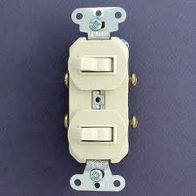
Energy Conservation is neither
E
  Energy Efficiency (EE) nor Depriving Yourself.
C

Slide 6
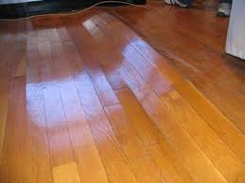
EC Measure (ECM) Definition
= ALL Benefits and Energy Savings are Used to Justify the Cost of Building Improvements
Benefits and Energy Savings > Costs
For this Client, Durability dwarfs Energy Savings.
This is a typical example of an Energy Conservation Measure. The repairs will not be justified by projected energy savings.

Slide 7
Energy Efficiency Measure (EEM) Definition
Reduced energy bills must exceed cost of improvement
No other economic benefits or problems of the improvement are considered
This approach wastes the opportunity to tap into ten times as much benefit than is gained by reducing the energy bill
An ECM can save your client more $$$ for much less $$$ invested!

Slide 8
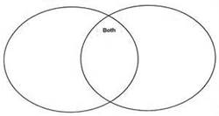
All EEM are ECM.
But EE Software will recommend some Hazardous EEM’s!
EEM
ECM
Close Crawl Space
Insulate Walls ?
Solar Water Heater ?
Weather Strip
Reduce Ventilation
Add Ventilation
Fluorescent Lamps
Add Vapor Barriers
Radiant Barrier ?
Skylights

Slide 9
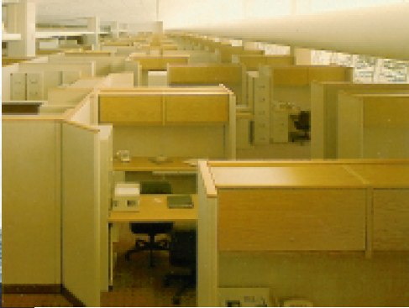
Productivity Gains Dwarf
Energy Savings
10 to 1
-Romm & Browning 1994

Slide 10
Typical Cash Flows of a Commercial Building $/sf/yr
Worker’s Salary 130
Insurance 1
Taxes 1
Repairs & Maintenance 1
Rent 18
Energy 2
Except Energy, the benefits of lowered costs are realized with an ECM but not an EEM.
15% Productivity Gain from ECM 22
-Romm & Browning 1994

Slide 11
Which are ECM?
Only 4 of these qualify! (Handout)
Multiple Light switches in a kitchen
Double-hung Windows vs Single-hung
Heat Exchanger Water Heater
Tankless Water Heater
Photovoltaics on a Home (RE)
Fiberglass batts over suspended ceiling
Insulating a crawl space with Fiberglass
Adding Skylights

Slide 12
Complete Energy Conservation
Definition (the following 3 are equivalent):
Build to the Neutral Cost Point
(Look for the ◊ blue diamond on the next slide)
Apply all ECMs
Spend no more on construction as building to the minimum building code, but avoid as much future energy consumption as possible

Slide 13
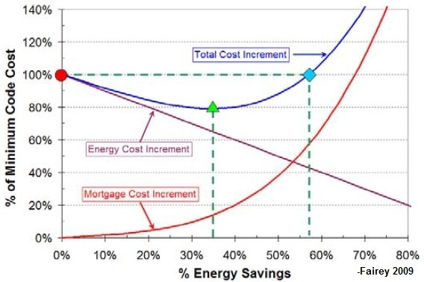
Fairey, 2009

Slide 14
57% savings is WIMPY!
The previous graph came from the Florida Solar Energy Center, one of the top building science institutions in the US.
Their software, like all others, is seriously hampered: it only models EEMs and cannot consider EC principles described in the 2nd part of this talk.
When more and richer ECM choices are available, much more cost-effective EC will be purchased.

Slide 15
The Energy Problem
&
Solution
in one Sentence:
Incomplete Energy Conservation causes extensive and economically unjustified harm.

Slide 16
The Energy Problem
We’re uncomfortable and less productive
Buildings & our health are threatened
Power outages shutdown our economy
Major economic problems are created
Our environment is suffering

Slide 17
Buildings are the Biggest Sector of US Energy Consumption
Almost 50% of all energy consumed in the US is used in/for/by buildings.
All non-renewable energy consumption can be avoided but some energy saving designs are not economical.
Avoiding more than 75% of that waste costs less than nothing!
Advanced buildings are currently being built with no additional real costs and incorporate the equipment to tackle the Energy Problem.

Slide 18
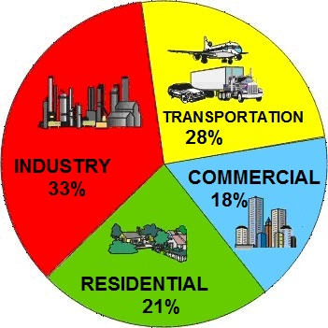
US Energy Consumption Sectors
http://eetd.lbl.gov/ee/ee-1.html

Slide 19
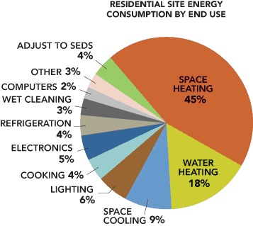
DOE

Slide 20
Where energy is used for Homes
47% Conversion and Transmission Losses
24% Space Heating
8.7% Water Heating
5% Sensible Space Cooling
2% Latent (moisture) Space Cooling
4.5% Lighting
3.5% Electronics i.e., TV
3% Refrigeration
2.8% Cooking
2.5% Clothes Dryers
1% Computers
3% Phantom Loads = Standby Waste
2.4% Other * % of Primary Energy

Slide 25
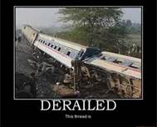
EC Derailed by Own Industry

Slide 26

Our Toolbox of EC Principles is Currently Too Poor to Fix the Problem

Slide 27
The Principles of EC Will
Fill our Toolbox
Here is a preview..
More comprehensive list of how Energy Travels
Moisture & moisture flows Really move energy
A comprehensive list of the Means of EC
Conditions Necessary for EC
Thorough treatment of the Economics of EC
Exploiting the key to The Energy Problem:
Retrofits

Slide 28
EC Derailed by Modeling Software
Current Energy Efficiency modeling computer software:
Ignores most Energy Conservation Means
Ignores conditions necessary to EC
Poorly handles major energy flows
Is ill-equipped for automated retrofitting

Slide 29
EC Derailed by Manufacturer Packaging
  Packaging misinforms by
  Telling us to install fiberglass batt insulation upside-down
  Poorly labeling the ratio of drying to cooling in AC literature
  Describing lighting efficiency only in lumens/watt which does not really tell us the efficiency in visible watts output / input watts

Slide 30
EC Derailed by Government Subsidies
  On-demand water heaters don’t save much money & cannot be upgraded to the best water heater technology
  Replacement windows challenge building durability
  Solar water heaters are too hard to maintain
  Externalized costs of fossil fuels depress the retail price of energy

Slide 31
EC Derailed by Industry Standards
HVAC sizing ignores diffusion
Ventilation needlessly pollutes
National Retrofit guidelines
    ignore moisture
    don't consider moving the thermal envelope or adding windows
    utilize standard energy modeling software!

Slide 32
EC Derailed by Building Codes
Mandate impermeable roof underlayments which undermine durability and EC
Unvented attics were not code-compliant until 7 years ago
Unvented crawl spaces are still not code-compliant in Louisiana
(We still waiting for acceptance of the 2012 code.)
Flood prone areas receive inappropriate mandates for crawl space ventilation

Slide 33
What it will take to do this:
Our problem as building industry professionals is not lack of government subsidies or energy taxes on our clients
It is our stubborn desire to hold on to broken paradigms…
INSTEAD CHANGE
to embrace this new paradigm and the prolific economic opportunities it provides!

Slide 34

The Energy Problem is in our hands

Slide 35
Part 2
"First Principles" proposes a set of science and engineering fundamentals for EC and tells us why we’re hot.

Slide 36
First Principles of Energy Conservation
The principles discussed here only highlight what is missing, needed or poorly contributes to current energy conservation work.
This is not a comprehensive list.

Slide 37
Principles of Energy Conservation
Energy Travels: more comprehensive treatment
Moisture: It’s an Energy Flow and Moisture Concentrations speed up energy flows
There are many more Means beside Efficiency
Necessary Conditions must be considered
Economic tools control and sell EC
Retrofitting tools that have been overlooked

Slide 38
EC Principles How Energy Travels
Conduction
Convection (heat flow via fluid flow)
  Advection (bulk fluid flow)
    Convection cells can have high R values
    Unbounded advection: e.g. infiltration
  Diffusion (flow through stationary matter)
    * Most important when water is moved
Radiation
  Emissivity more importance than reflection

Slide 39
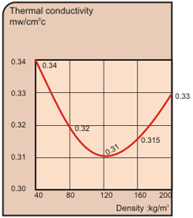
Conduction in
Loose Fill Insulation is Density Dependent

Slide 40
We understand Advection
Convection Cells
Infiltration into our buildings
  Often caused by wind or
  Stack effects
Duct Leakage
We were just using the wrong name and always called it Convection. No Problem.. just a name.
Notes:
40

Slide 41
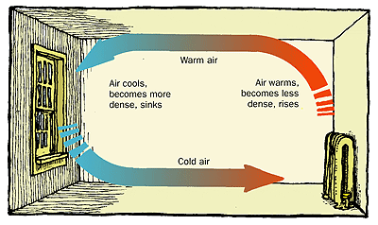

Slide 42
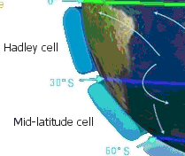

Slide 43
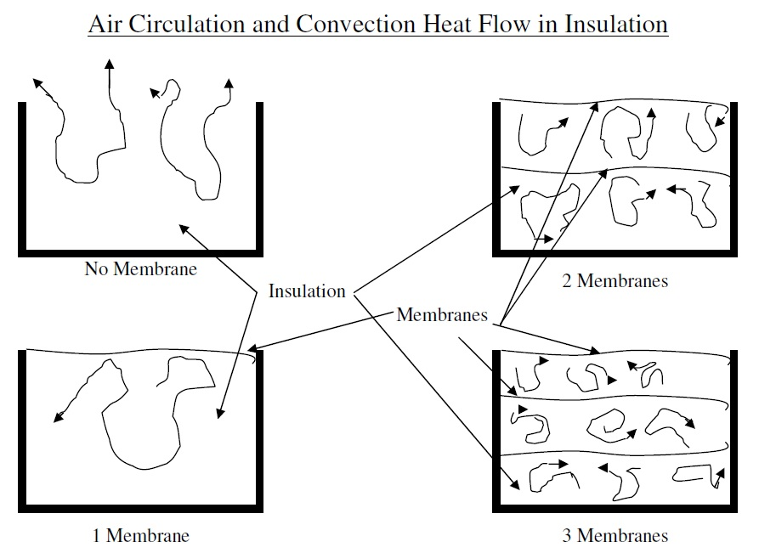
Advective Heat Flows in Insulation
Schematic Drawings of Insulation Between Joists on the Floor of an Attic
Lower Example has a Membrane over the Insulation
-Bullock 1986

Slide 44
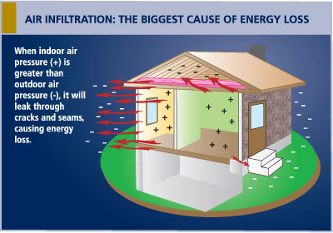

Slide 45
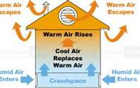

Slide 46
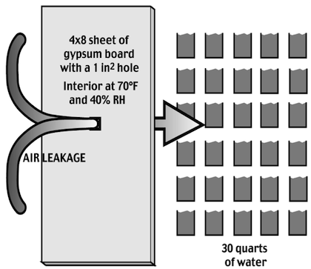

Slide 47
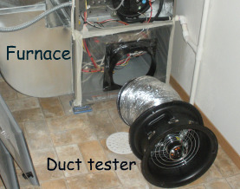

Slide 48
Diffusion is also Convection
Unlike Advection,
Diffusion occurs when fluid is passing through other matter that is otherwise relatively stationary
Diffusion can travel through a liquid, gas or solid
For building science, we’re interested in diffusion through gas & solids. Biologists and doctors focus upon diffusion through liquid

Slide 49
Diffusion is also Convection
We are interested in water flows pushed by
Capillary Action
Change in Concentration
Osmotic forces
Condensation
Evaporation
But bulk moisture flow like rainwater or leaky pipes is not diffusion.

Slide 50
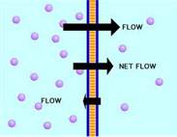
Diffusion is also Convection

Slide 51
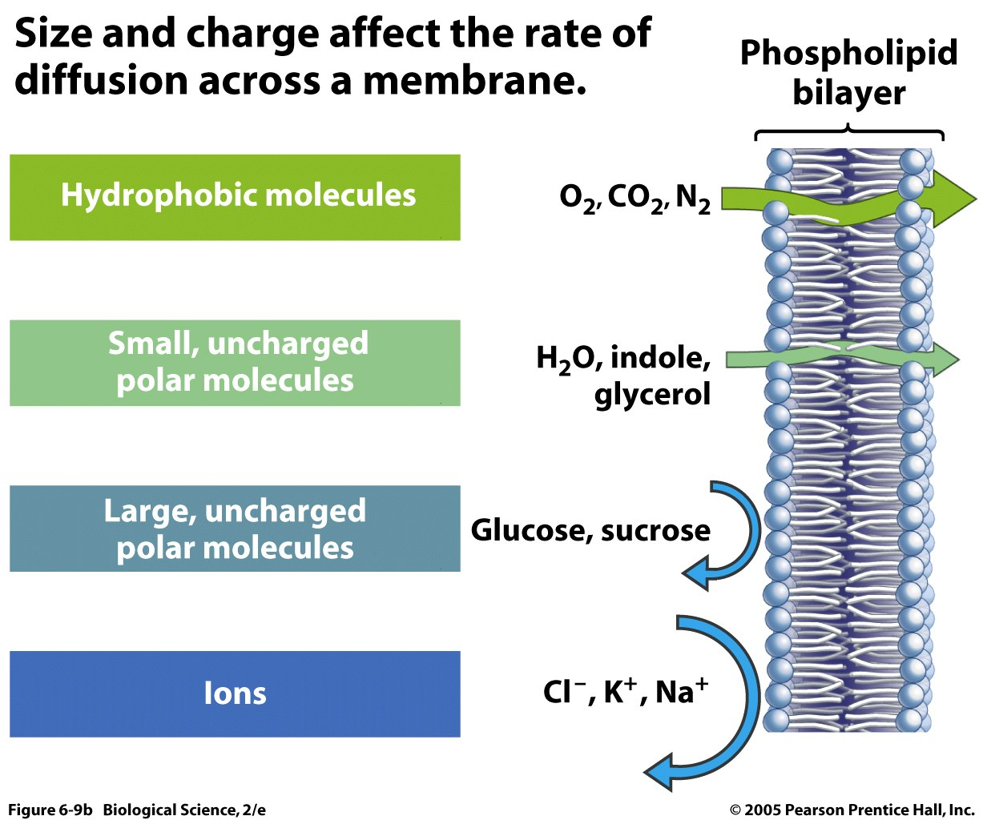

Slide 52
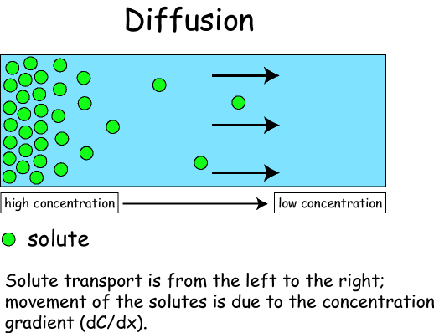

Slide 53
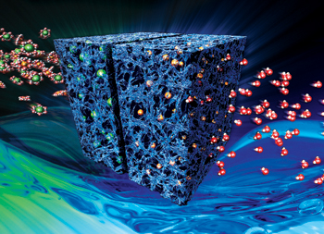

Slide 54
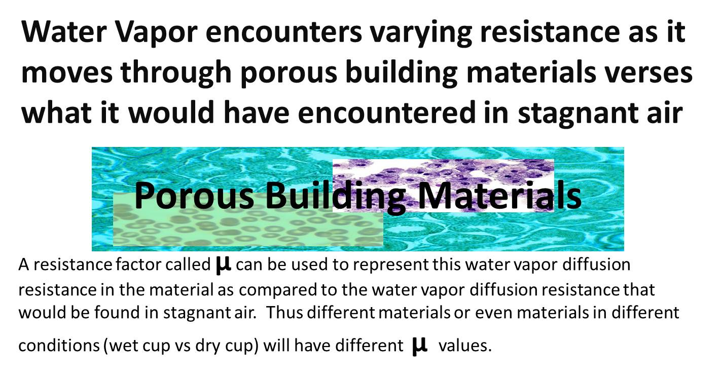

Slide 55
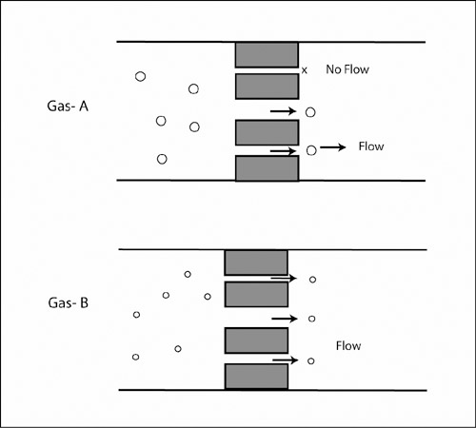

Slide 56
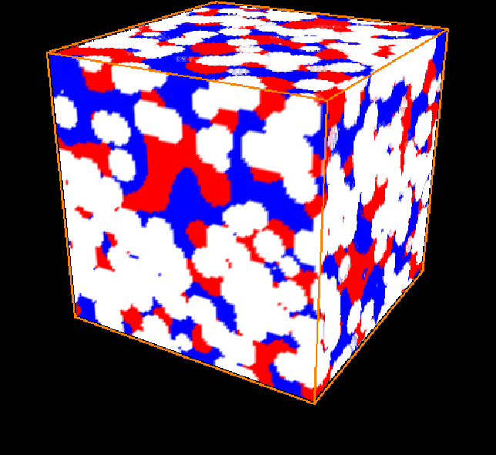

Slide 57
Radiation is by
Electromagnetic Waves
Emissivity is very important in building science. It is needed to explain:
Radiant Barriers
Heat flow through windows
Comfort in homes
Cooling of Earth

Slide 58
Radiant Barriers Work Primarily by Emissivity
Shiny metal surfaces emit very poorly:
Aluminum foil has very low emissivity
Corrugated galvanized exterior surfaces tend to heat-up in the sun despite high reflectivity because of low emissivity
White roofs are both reflectors and emitters; that’s why they outperform metal roofs

Slide 59
1st Principles of EC: Moisture
Durability & Health are very affected
Moisture Content raises conductivity
Equilibrium Moisture Content is the same for all wood types
Evaporation moves lots of heat
Average dew points have risen dramatically

Slide 60
1st Principles of EC: Moisture
Building failure is often driven by cooling
Diffusion is very important if a change of state occurs
A hydrogen bond is a “physical state”
Stacked Convection cells with semi-permeable boundaries form desiccants
Hygric Mass is very important

Slide 61
1st Principles of EC: Moisture
Drying is a natural solar-powered flow
Osmotic flows can destroy stone
Ventilation encourages pollution
Genus Homo mutations/innovations include: - evaporative cooling & - little hydrophobic covering

Slide 62
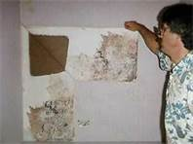

Slide 63
“… thermal conductivity … of dry, stagnant air… is … an order of magnitude lower than … water…
“If the air is displaced, be it by means of direct or indirect penetration of vapour or water, then the insulating material looses a great part of its insulating abilities and ceases to operate in its forethought role.”
-Chadiarakou 2007

Slide 64
Moisture Content (MC)
is defined in two slightly different ways:
Ratio of weight of water to weight of dry material. This is used for wood and is always expressed as a percent and can be greater than 1.
Ratio of weight of water to the maximum weight the material can hold.
We will use both definitions; the distinction is not important to this talk.

Slide 65
MC Increases Conductivity

Slide 66
Equilibrium Moisture Content (EMC)
EMC is the MC a material will reach after adequate acclimation time has passed when exposed to a particular environment.
For wood flooring materials, acclimation is performed within the building where installation takes place and with HVAC on and thus within a narrow range of temperature (T) and relative humidity (RH).
EMC increases with RH and decreases with T.
-US Forest Products Laboratory 1960

Slide 67
Equilibrium Moisture Content (EMC) ALL WOOD TYPES Temperature °F
 | 40 | 50 | 60 | 70 | 80 | 90
45 | 8.7 | 8.7 | 8.6 | 8.5 | 8.3 | 8.1
50 | 9.5 | 9.5 | 9.4 | 9.2 | 9.1 | 8.9
55 | 10.4 | 10.3 | 10.2 | 10.1 | 9.9 | 9.7
60 | 11.3 | 11.2 | 11.1 | 11 | 10.8 | 10.5
65 | 12.3 | 12.3 | 12.1 | 12 | 11.7 | 11.5
70 | 13.5 | 13.4 | 13.3 | 13.1 | 12.9 | 12.6
75 | 14.9 | 14.8 | 14.6 | 14.4 | 14.2 | 13.9
80 | 16.5 | 16.4 | 16.2 | 16 | 15.7 | 15.4
85 | 18.5 | 18.4 | 18.2 | 17.9 | 17.7 | 17.3
90 | 21 | 20.9 | 20.7 | 20.5 | 20.2 | 19.8
95 | 24.3 | 24.3 | 24.1 | 23.9 | 23.6 | 23.3
98 | 26.9 | 26.9 | 26.8 | 26.6 | 26.3 | 26.0
Relative Humidity %

Slide 68
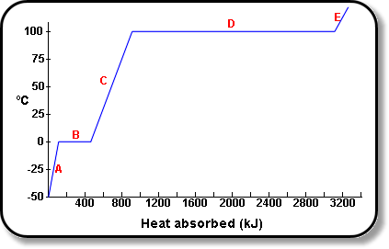
Heat of Vaporization is 2200 kJ/kg.
But, another 400 kJ/kg is needed to heat 25C water to the boiling point.
Evaporation Energy = ~2600 kJ/l

Slide 69
1st Principles of EC: Means
Efficiency (less energy does the same job)
Control (do the same job but at varying times)
Environmental Coupling (utilize energy flows from outside)
Timing (use energy later than it was generated, collected or stored)
Low gradients (use smaller temperature difference)
Revise goals (alter goal of energy end use)

Slide 70
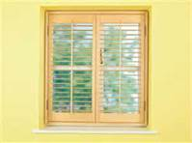
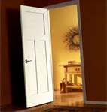
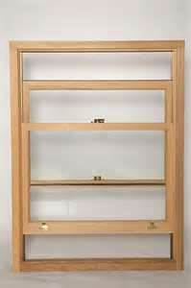
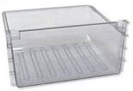
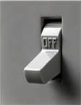
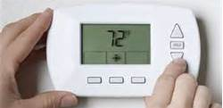
Tools of Control

Slide 71
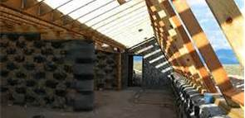
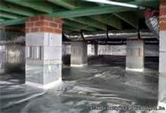
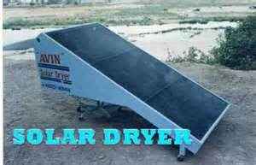
Environmental Coupling

Slide 72
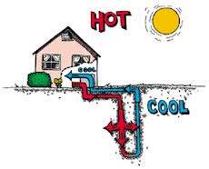
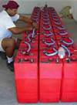
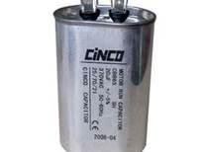
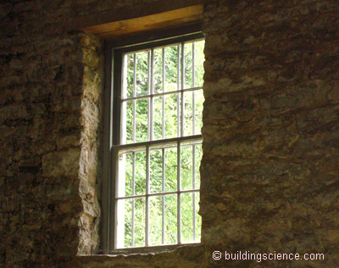
Timing

Slide 73
1st Principles of EC: Means
Ancillary effects (fully credit positive ancillary effects of an energy flow)
Anti-Ancillarity (fully credit negative ancillary effects of an energy flow)
Minimize production and transmission losses of primary energy
Minimizing phantom or standby loads
Flexibility (vary ratio of output end uses)

Slide 74
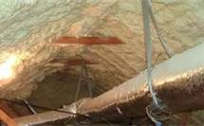
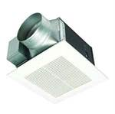
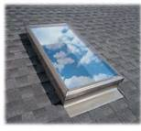

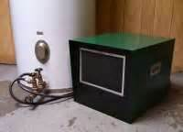
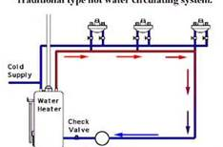
Ancillary Effects

Slide 75
1st Principles of EC: Means
Decoupling (disassociating End Uses)
2nd generation/higher quality End Uses
Proximity (deliver energy closer to need)
Long cycling (utilize long on/off cycles instead of short cycles)
Renewable Energy (actively collect natural energy flows)

Slide 76
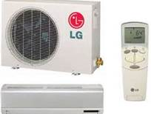
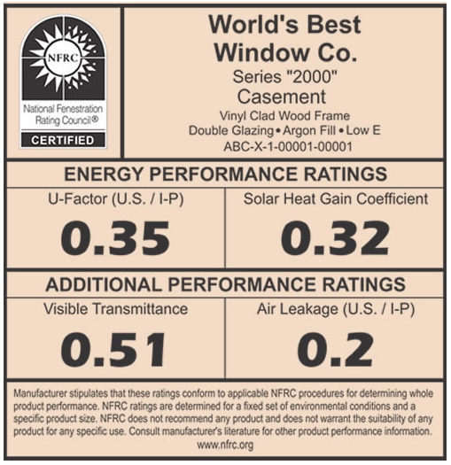
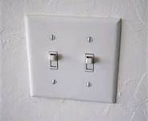
Decoupling

Slide 77
EC Principles:
Conditions Necessary
Productivity (worth 10 x cost of energy)
Reliability (worth > $5000 / home)
Resilience (withstands natural insults)
Insurance (about 1/2 the cost of energy)
Travel Expense (cost to travel to work)

Slide 78
EC Principles:
Conditions Necessary
Affordability (energy will only be saved if the consumer can afford to reach the goals before the improvement / retrofit is implemented.)
Maintenance (1/2 cost of energy )
Installation Quality (difficulty to install and ease to inspect )
Incentive (energy is only saved when a consumer sees a significant benefit )
Durability (preserving the life of the building)

Slide 79
EC Principles:
Conditions Necessary
Pest Control (mold, termites, rot)
Health
Comfort (Can’t over-emphasize this! What is this worth?)
Safety
Sustainability

Slide 80
Principles of EC: Economics
$/kWh saved
are the same kind of apples as
$/kWh generated
Dispatch is the enemy of EC, i.e.,
we're buying power but we only need energy.
$/W of uninstalled PV had declined with a half-life of 8 years. For the last 3 years, the half-life has been 2 years. Current Price is $0.50 /W

Slide 81
Principles of EC: Economics
Levelized cost of energy has been commonly used to compare various power-plant technologies
Levelized cost of building design strategies could be compared via $/kWh saved.
Assertion: the Energy Problem can be solved with a net-zero, levelized cost of building design. And, thereby, with a zero net-cost to the global economy.

Slide 82
Principles of EC: Retrofits
Capturing all means of EC is missing because
  Moisture flows are not appreciated
  Moving thermal envelope is ignored
  Adding windows is ignored
  Recommendations depend upon broken models
The problem/opportunity is much richer in each existing building than in new buildings AND there are many, many more existing buildings!

Slide 83
Part 3
Applying EC principles to important and challenging real-world building problems

Slide 84
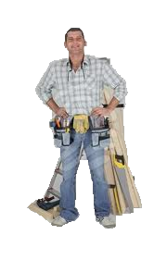
Got our tools
Let’s go solve important & common, real-world practical problems!
Notes:
84

Slide 85
Applying EC Principles to Real World Problems
The Cotton Undershirt or T shirt... why does it keep you cooler in the summer?
How to install a radiant barrier
Choosing a water heater
Why do you often feel colder in very high RH in the winter?

Slide 86
Applying EC Principles to Real World Problems
How to install a wooden floor
Crawl Space... How should it be insulated?
Attic... How should it be insulated?
Underwear for buildings… or where do vapor barriers go?

Slide 87
Applying EC Principles to Real World Problems
What type of AC system should be installed?
How to avoid the energy flow within buildings which currently generates the highest cost in LA?
How can building designers stop the flow that will cost LA the most in the long term?

Slide 88
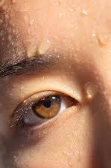

Why does a cotton undershirt keep you cooler in the summer?
We are constantly sweating, even though we may not notice it. Sweating is your body's major way of getting rid of excess body heat, which is produced by metabolism or working muscles. The amount of sweat produced depends upon our states of emotion and physical activity. Sweat can be made in response to nerve stimulation, hot air temperature, and/or exercise.
-health.howstuffworks.com

Slide 89
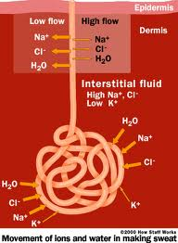
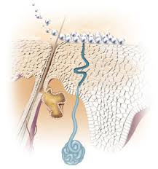
Why cotton keeps you cooler

Slide 90
Heat of Vaporization is 2200 kJ/kg.
But, another 400 kJ/kg is needed to heat 25C water to the boiling point.
Evaporation Energy = ~2600 kJ/l

Slide 91
Moisture Increases Conductivity

Slide 92

Why does a cotton undershirt keep you cooler in the summer?
When sweat evaporates from the surface of your skin, @ one liter/hour, it cools you @ 0.7 kW.
(Evaporation energy = ~2.6 x 10⁶ joules/liter , W = joule/second & hour = 3,600 seconds.)

Slide 93
T-shirts Speed Cooling by:
Evaporation; they increase surface area available for heat loss both on your shirt and on your body.
Conduction since your skin touches a cooler object which conducts much better when wet. And, cotton conducts 20 times as well as wool when dry.

Slide 94

How to install a radiant barrier
Emissivity is more important than reflection, particularly in an attic

Slide 95

What is the 2nd hottest part of an attic?

Slide 96


Slide 97


Slide 98
How to install a radiant barrier
Shiny-side down impedes downward heat flows coming into the attic … BUT?

Slide 99
Best Radiant Barrier Installation
Place Radiant barrier just below roof and rafters because rafters will conduct heat around the barriers if attached to the roof deck.
Install Radiant Barrier shiny-side down to
  impede downward heat flows
and not on top of attic floor insulation in order to
  keep radiant barrier free of attic dirt, which would raise emissivity and turn off the barrier
BUT…

Slide 100
A radiant barrier can cause moisture problems in a vented attic with ducts, if installed above the duct system. Sweating Ducts! A faulty solution is to use very high R-values for duct insulation and very tight ducts. However, Bad plan. Too likely to fail!
Good Solutions for our climate:
  incorporate radiant barriers into the roof/attic insulation system to “unvent” the attic, or
  place the entire HVAC system below the ceiling.

Slide 101
Why include Radiant Barriers in this talk?
Many OTHERWISE great energy saving solutions generate HAZARDOUS moisture problems in our climate and a radiant barrier is one of them.
Neither moisture effects nor the actual heat flow effect of the radiant barrier is calculated by energy-efficiency software.

Slide 102
Choosing a Water Heater
Remember, the ECM goal is to SAVE MONEY first and SAVE ENERGY as a consequence… Not the other way around!
Our choices are limited to:
Electric Solar Gas
Tanked or not Tanked
( in same order on next slide )

Slide 103





Water Heater ¢/kWH
9
12
2
3
7

Slide 104
Heat Pump Water Heater (HPWH) is the Best Choice
Solar Thermal water heaters are barely sold in our climate despite major local, state & federal subsidies because they are too hard to maintain!
Ancillary benefit of HPWH: Cooling and drying inside air… Perhaps bigger benefit than marginally better water heating efficiency
Efficiency of HPWH is largely derived from operating at low gradients and timing

Slide 105
Why do you often feel colder in very high RH during the winter?
I don’t know.
This may be an unsolved problem.
I have some interesting theories!!
Perhaps someone will ask about this at the end of the talk.

Slide 106
How to install a wooden floor
The EMC wood table indicates that MC is very dependent upon RH and T (to a lesser extent)
Wood will tend to swell or contract during gain or loss of MC, respectively
To provide durability to a modern floor, extensive cooling energy is needed,
UNLESS…

Slide 107
Equilibrium Moisture Content (EMC) for ALL WOOD TYPES Temperature °F
 | 40 | 50 | 60 | 70 | 80 | 90
45 | 8.7 | 8.7 | 8.6 | 8.5 | 8.3 | 8.1
50 | 9.5 | 9.5 | 9.4 | 9.2 | 9.1 | 8.9
55 | 10.4 | 10.3 | 10.2 | 10.1 | 9.9 | 9.7
60 | 11.3 | 11.2 | 11.1 | 11 | 10.8 | 10.5
65 | 12.3 | 12.3 | 12.1 | 12 | 11.7 | 11.5
70 | 13.5 | 13.4 | 13.3 | 13.1 | 12.9 | 12.6
75 | 14.9 | 14.8 | 14.6 | 14.4 | 14.2 | 13.9
80 | 16.5 | 16.4 | 16.2 | 16 | 15.7 | 15.4
85 | 18.5 | 18.4 | 18.2 | 17.9 | 17.7 | 17.3
90 | 21 | 20.9 | 20.7 | 20.5 | 20.2 | 19.8
95 | 24.3 | 24.3 | 24.1 | 23.9 | 23.6 | 23.3
98 | 26.9 | 26.9 | 26.8 | 26.6 | 26.3 | 26.0
Relative Humidity %

Slide 108
Unless, moisture is kept out in the first place
Since a wooden floor is more affected by moisture than temperature, keep the RH of the air near the floor as constant and close to 50% as possible.
  The expensive way is to run the AC 24/7!
  The economical way is to keep the moisture out in the first place.
See crawl space problem for how to do that!

Slide 109
However, if floors are not installed tightly, the problem also goes away
The reason the problem comes up: the National Wood Flooring Association encourages floors to be installed, after acclimating to an AC-controlled climate, which is normally very near 9.2 MC
If installed the old way, before AC was common, the floor will not warp, but have 1/32” spaces between floor boards in the winter. BIG DEAL?

Slide 110

Crawl Space How insulated?

Slide 111
Crawl Space Insulation Problem
Ambient air dew points in New Orleans have risen dramatically to a 78F monthly average.
This means that normal cooling set points of AC system will drive subfloor wooden components below dew point.
Until recently, the building code mandated insulation between joists--a recipe for mold, rot and warped floors.

Slide 112
Crawl Space Insulation Problem
For heat and moisture reasons, the best place to insulate is along the walls of the crawl space--and create them if missing.
2006 building code requires "operable" vents for homes in a flood plain.
LA Structural Pest Control Commission has restrictions about proximity of materials to the soil. Their concern is termite infestation.

Slide 113
Crawl Space CODE Problem
2009 Building Code
N1102.2.7 (R402.2.7) Floors.
Floor insulation shall be installed to maintain permanent contact with the underside of the subfloor decking.

Slide 114
2012 Building Code. N1102.2.10 (R402.2.10) Crawl space walls.
[if] the crawl space is not vented to the outside. Crawl space wall insulation shall be permanently fastened to the wall and extend downward from the floor to the finished grade level and then vertically and/or horizontally for at least an additional 24 inches (610 mm). Exposed earth in unvented crawl space foundations shall be covered with a continuous Class I vapor retarder in accordance with this code. All joints of the vapor retarder shall overlap by 6 inches (153 mm) and be sealed or taped. The edges of the vapor retarder shall extend at least 6 inches (153 mm) up the stem wall and shall be attached to the stem wall.

Slide 116
Crawl Space Problem
However, what if your client’s problem occurs before the 2012 code is accepted?
Note that the 2012 code is nether responsive to the requirements of the
  LA Structural Pest Control Commission or
  Flood areas which mandate ventilated walls
You have to figure it out on your own… Which I did. Here are my specifications from 2010.

Slide 117


Slide 118


Slide 119


Slide 120


Slide 121
Crawl Space Solution
The solution meets all requirements and is:
  Cheaper to install
  Easier to inspect
  Better ground Coupling => lower energy bills
  Easier to maintain, and
  More comfortable
Note: this solution can be modeled with Energy Efficiency software but moisture will not be analyzed and the process will be far from automatic.

Slide 122
Attic. How insulated?
As explained in the Radiant Barrier discussion:
A radiant barrier is really a good idea
So is unventing & insulating @ the rafters.
The first will block a formidable amount of heat
The second will resolve a host of problems for HVAC equipment with ducts in the attic.
However, how do you do both & avoid moisture issues?

Slide 123
Attic Insulation… How?
The common solution--blown in foam onto the bottom of the roof deck--has been the default answer for 5 years.
But is this a good solution? And, where is the radiant barrier?
There is no radiant barrier… but if installed correctly, the R-value is so high that a radiant barrier may not be needed.

Slide 125
Foamed Attic => Moisture Issue
The problems with this approach:
  Costly
  Next to impossible to inspect insulation depth
Moisture is the primary problem.
  Moisture migrates up and cannot escape as fast as it is generated because the diffusion rate has been reduced too much.

Slide 126

Attic Solution

Slide 127
Attic Insulation System
Staple perforated aluminum foil to bottom of roof deck.
Staple and seal un-perforated aluminum foil to the sides of the studs 1" away below the first aluminum layer.
Fill the rest of the rafter-cavity with high-borate cellulose.
The air space between the Al layers must connect to outside.

Slide 128
Critique of
Attic Insulation System
Costs more than a foam system because of labor.
Lower Al layer must be carefully inspected to insure proper seal.
System is hard to justify based simply upon an EEM’s benefit / cost analysis.
System is a solar-powered dehumidifier--but the rate of dehumidification is unknown.
I have many ideas about how to calculate drying.

Slide 129
AC Installation … How?
It is hard to believe that the AC industry doesn’t know that duct systems have many, many problems…so many, that it’s unreasonable to think that people would still want them. However, our buildings are full of them, so here goes…

Slide 130
AC Installation & Operation Problems
Next slide shows common installation problems found near the blower / evaporator / furnace section.
Clogged coils, dirty filters, undersized returns… all contribute to too low an airflow to maintain efficiency.
Leaky ducts, ducts outside of conditioned space and closed inside doors all contribute to duct leakage and infiltration.

Slide 131

Undersized Return Ducts
40% Duct Leaks
Heat loss to Attic
Dirty Coil
Improper Gas Charge
Closed Doors
Dirty or high MERV filters

Slide 132
Chokepoints Starve System of Airflow, Energy and Efficiency
“Over 88% filters restrict airflow.
Over 85% A/C evaporative coils restrict airflow and heat exchange.
Over 80% of return air ducts restrict airflow primarily due to filter sizing.
Over 72% of HVAC systems have improper charge, reducing heat exchange, damaging compressor.”
EverCleanGreen.com

Slide 133
Most Energy Conserving
AC system
A Ductless MiniSplit system outperforms a ducted system in many ways.

Slide 134
MiniSplit Advantages
Much less expensive to buy or repair
90% of Installation can be done without installation AC skills.
Automatically zoned
More flexibility: cool, dry, heat. Although the “dry” setting is not pure drying, it really helps.
Naturally decoupled:
  dehumidification from delivery

Slide 135
MiniSplit Advantages for Attic
Since there are no ducts, the attic does not need to be unvented
The easy way to insulate on the floor is fine, as is the radiant barrier just below the rafters.
This technology is much cheaper than all other alternatives and it does not create moisture problems.
And, this HVAC solution makes insulating the attic much, much cheaper and effective.

Slide 136
Underwear for Buildings
Just like a tree, moisture naturally flows from the bottom and sides of the building up into the attic.
If a building’s shell impedes flows from the bottom and sides, and encourages moisture flows up, the building will tend to dry.
However, this effect IS NOT SIGNIFICANT IN A MODESTLY LEAKY BUILDING.
Tyvek™ is not the right housewrap for this.

Slide 137
Underwear for Buildings
Although we may not get net drying of the building sufficient to significantly lower the air’s RH, we may affect the dryness of the building shell in a very positive way… thereby increasing the R-value of those components.
Evidence from Greece suggests that we may be putting vapor barriers on the outside of our buildings soon.

Slide 138
Underwear for Buildings
The crawl space system already described is highly compatible.
The attic solution is also highly compatible.
Abandoning the use of a bathroom exhaust fan would help.
But that might require a Heat Pump Water Heater.

Slide 139
How to Avoid the Energy Flow within LA Buildings Which Generates the Highest Cost?
You probably guessed it by now. It is moisture.
Most of the previous discussions deal with moisture problems.
It will take a well-orchestrated approach.
Even a refrigerator and clothes drier can contribute to the solution.
We will need experiments & calculations.

Slide 140
How Can Engineers Stop the Energy Flow That Will Cost LA the Most in the Long Term?
I believe that the use of fossil fuel is the problem. This will lead to inundation of our land.
If most buildings are retrofit with complete EC which includes a minimal PV system and battery backup sufficient for 24 hours, we can get this done!

Slide 141
Once Energy Conservation (EC) in Buildings is redefined in market-based terms, it can overcome industry obstacles and solve "The Energy Problem."
"First Principles" proposes a set of science and engineering fundamentals for EC and tells us why we’re hot.
Applying EC principles to important and challenging real-world building problems. Fun & Lucrative!

Slide 142
Myron Katz, PhD
Energy Conservation and Moisture Consulting
Building Science Innovators, LLC
302 Walnut St
New Orleans, La 70118
Myron.Katz@EnergyRater.com
Notes:
142

Slide 143
References
Fairey, P & Veiera, R, Energy Efficiency Cost-Effectiveness Tests of Residential Code Update Process, FSEC-CR-1794-09, February 27, 2009
http://buildingsdatabook.eren.doe.gov/TableView.aspx?table=2.1.5
http://en.wikipedia.org/wiki/Convection
http://cbe255.che.wisc.edu/diffusion.pdf
www.evercleangreen.com/biggestenergywaste.html
Membranes Improve Insulation Efficiency, Chris Bullock, 1985.
http://nfrc.org/
Ye, Z and Wells, CM and Carrington, CG and Hewitt, NJ (2006) Thermal conductivity of wool and wool-hemp insulation. International Journal of Energy Research , 30 (1) 37 - 49. 10.1002/er.1123

Slide 144
”Greening The Building And The Bottom Line, Increasing Productivity Through Energy-Efficient Design“ Joseph J. Romm, U.S. Department Of Energy And William D. Browning, Rocky Mountain Institute 1994. http://www.rmi.org/Knowledge-Center/Library/D94-27_GreeningBuildingBottomLine
http://www.inive.org/members_area/medias/pdf/Inive/PalencAIVC2007/Volume1/PalencAIVC2007_039.pdf
http://www.roymech.co.uk/Related/Thermos/Thermos_insulation.html
http://health.howstuffworks.com/skin-care/information/anatomy/how-sweat-works2.htm

